Slide 1
Power BI Administration
Narisorn Limpaswadpaisarn

Slide 2
Meet me
Narisorn Limpaswadpaisarn
Partner Technologies Strategist, Microsoft
MCT
ITIL V4
Azure Admin Associated & Azure Specialists, M365 Message Admin
MCSE Productivity & Data Management and Analytics
MCSA BI Reporting & Office 365
MCP
MTA Databases
Microsoft Office Specialist 2016 Master
Email a-narli@microsoft.com
Facebook https://facebook.com/narisorn.li
LinkedIn https://www.linkedin.com/in/narisorn-limpaswadpaisarn-497b6410b
Instagram @Narismadz
Blog https://medium.com/echoo365
Narisorn Limpaswadpaisarn, Technology
Strategist at Microsoft. Once graduated
from SIIT TU and Sasin MBA, he realized that the trend is heavily on Cloud Computing.
He has some background on Networks and Electrical Engineering. Experiences in Marketing and Computer Networks, but mostly in Music production. He usually play guitar and MOOC on cloud technologies such as SQL, BI, Offices 365 and Server platforms. His role supports customer and Microsoft partner. He got several certifications and awards including MCT, MCSE, MCP and One Microsoft Award.

Slide 3
Agenda
Power BI Plans
Power BI Desktop
Sharing in Power BI
Power BI Services
Report vs Dashboards
Securities and Identities
Power BI Gateways
Dataflows
Performance, Model and Monitoring

Slide 4

Shared Power BI (cluster)
*** If using Power BI premium, you’ll get dedicated Backend VM
Shared Frontends
Shared Backends
Front End
Load Balancer
(Public)
Frontend VM
Backend VM
Backend VM
Frontend VM
Backend VM
Backend VM
Frontend VM
Backend VM
Backend VM
. . . . .
. . . . .
Metadata DB
Storage
Power BI Service
Notes:
https://docs.microsoft.com/en-us/power-bi/service-publish-to-web#limitations

Slide 5
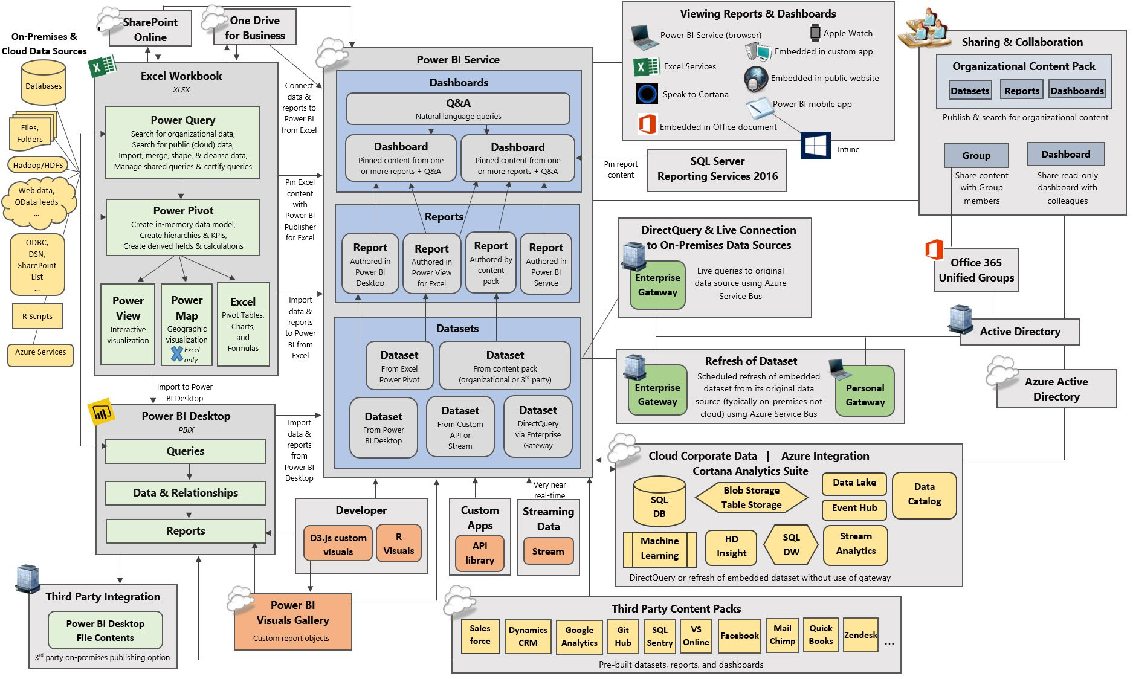

Slide 6
Power BI Plans
Narisorn Limpaswadpaisarn

Slide 7
Power BI portfolio
Shared capacity
Premium capacity
Embedded capacity
Power BI Desktop
Power BI Pro
Power BI Premium
Power BI Embedded
Licensed by user
Licensed by user
Licensed by capacity
Licensed by capacity
Free report authoring and ad-hoc data exploration
Quick, easy-to-use self-service analytics for users requiring collaboration, dashboard sharing, ad hoc analysis, and report publishing
An add-on to Power BI Pro for projects requiring large scale data, demanding performance, and the ability to distribute content without requiring per user licensing
A developer offering for deploying analytics and visuals into applications. An add-on to Power BI Pro for applications that are built and distributed without requiring per user licensing

Slide 8
Power BI user license tiers
User that sign-up trial will get Pro features for 30 days and will convert to free (Basic).
Free (Basic)
Pro
($10/user/month)
Connect to 70+ data sources
Publish to web
Peer-to-peer sharing
Enterprise distribution
Applications
Email subscriptions
Embed APIs and controls
Collaboration
Applications
Analyze in Excel, analyze in Power BI Desktop
Support
Community
Community and more*
*For tenant administrators, phone support from Microsoft; for Pro users, email support from Microsoft.

Slide 9
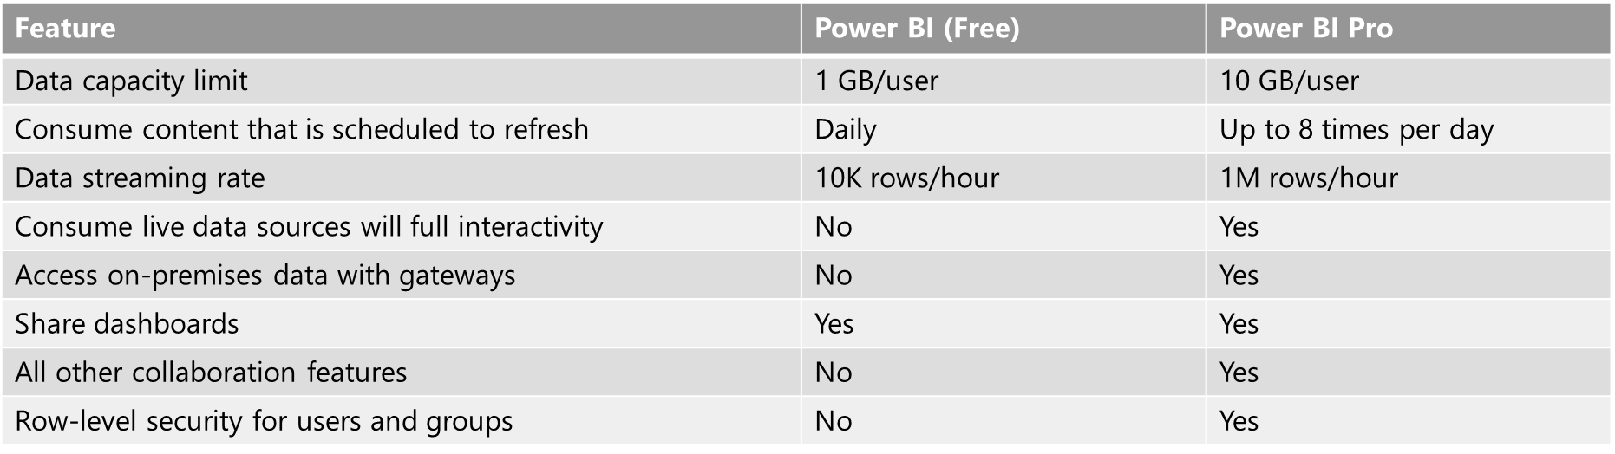
Power BI free vs Pro
https://docs.microsoft.com/en-us/power-bi/service-features-license-type
(Storage size)

Slide 10
Acquire Power BI
Optional
Power BI Pro
Power BI Premium
+
Standalone
$9.99/user/month
Add on to Power BI Pro
Includes Power BI Report Server
Office 365
Included in E5
Add on for E1/E3
Concurrently deploy an equivalent number of cores on-premises
Customers with SQL EE SA also have access to Power BI Report Server as a SA benefit
Power BI Embedded is acquired as an Azure service.
Dynamics 365 licenses and plans do not include Power BI Pro licenses or any other Power BI license entitlements, but Dynamics 365 users may access embedded Power BI content that is available within the Dynamics 365 user interface.

Slide 11


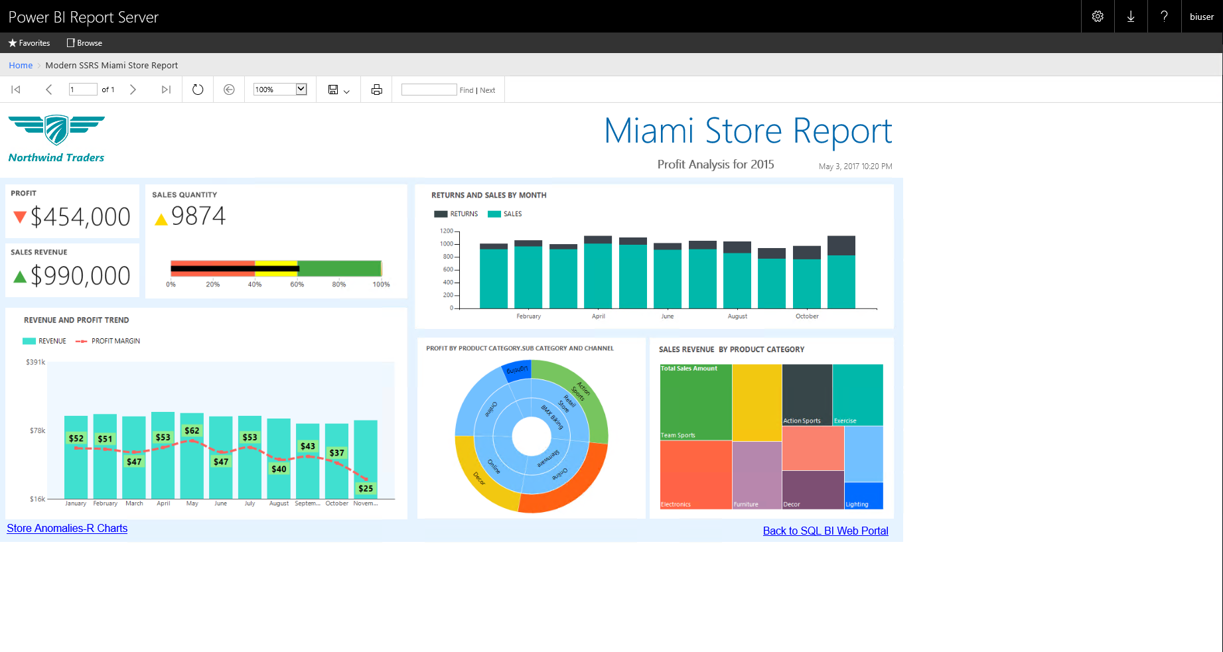
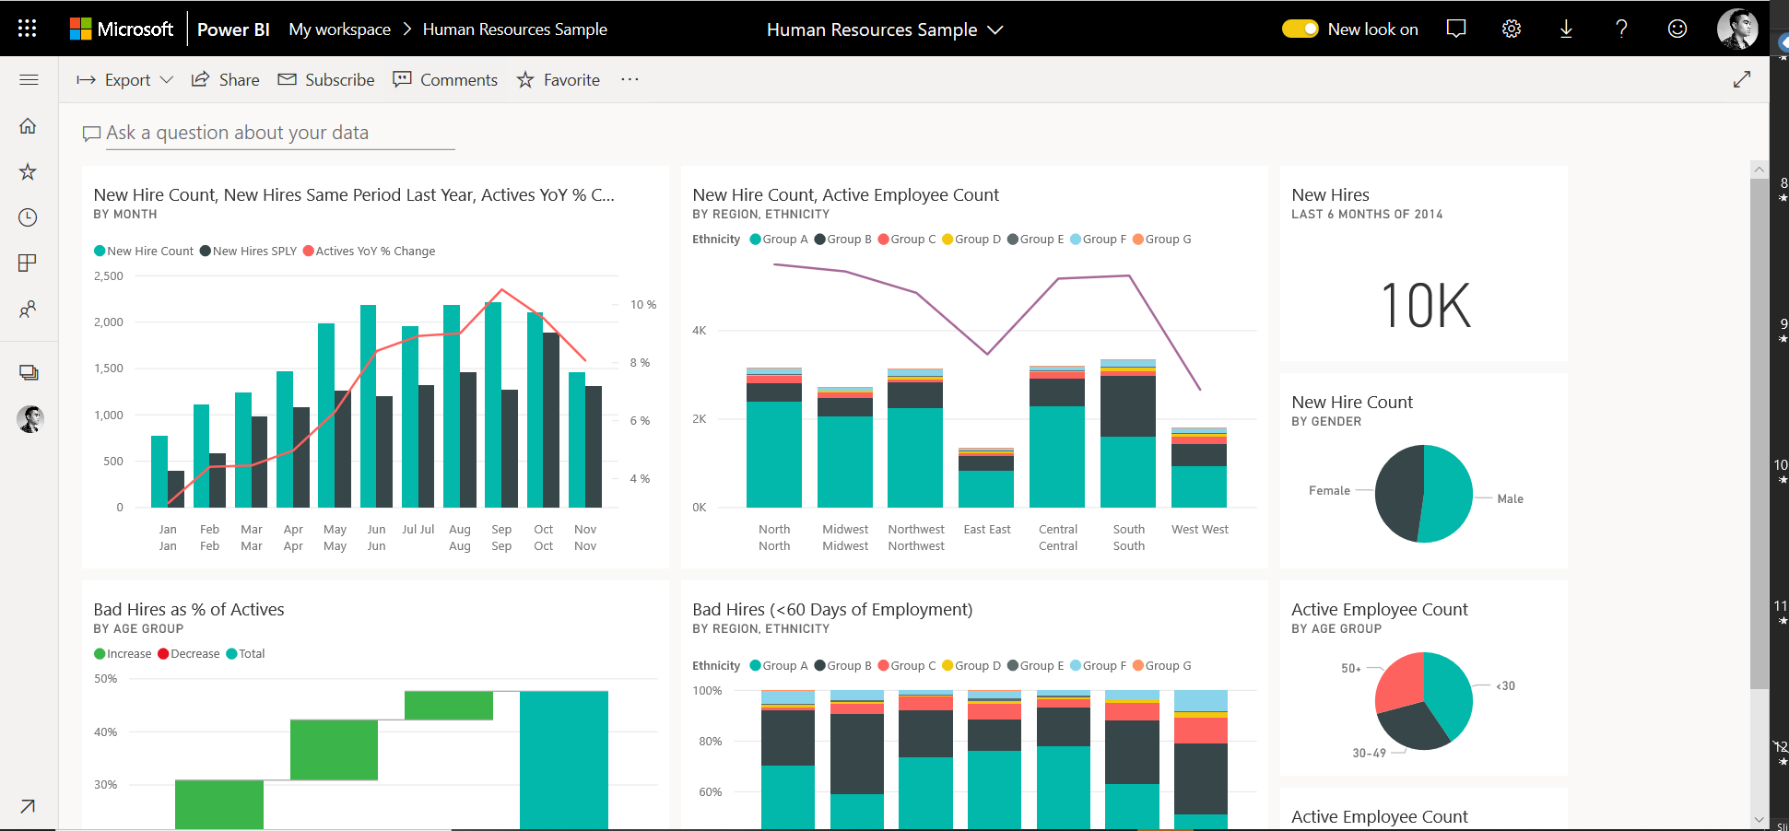
SSRS reports and the cloud
Power BI Report Server
Take your on-premises investments to the cloud
Power BI Report Server
Power BI reports
Power BI reports
SSRS reports
Get started quickly
Custom
Visualizations
Live Dashboards
Natural Language Query
Custom Visualizations
Power BI Report Server
Power BI

Slide 12



How to acquire Power BI Report Server
Purchase Power BI Premium
Concurrently deploy an equivalent number of cores in the cloud and on-premises
Purchase SQL EE SA
Customers with SQL EE SA have access to Power BI Report Server as a SA benefit
Power BI Pro license required to publish Power BI reports to Power BI Report Server for further distribution

Slide 13



Compare reporting options
Report server can do custom theme for portal
SQL Server Reporting Services
Power BI Report Server
Power BI Service
Power BI Embedded
Deployment
On-premises
On-premises
Cloud
Cloud
Power BI reports
Real-time dashboards
Content packs
Q&A
Quick Insight
Paginated reports
Mobile reports
Lifecycle
Fixed lifestyle policy
Modern lifestyle policy
Fully managed service
APIs

Slide 14
Modern Lifecycle Policy
Deploy updates on your terms and timing
Year 1
Year 2
Frequent releases (planning for approximately 3 per year)
Security & Critical Updates
Security Updates (Only)
Release 1
Critical and security updates until next release
Security & Critical Updates
Security Updates (Only)
Release 2
Security updates continue for the remainder of the 12 month release lifespan
Security & Critical Updates
Security Updates (Only)
Release 3
New Release
Support Ends

Slide 15
Collaboration vs. consumption
Premium without pro
Pro
Embedded
Self-service & collaboration —licensed per user
Basic consumption—
not licensed per user
External consumption —not licensed per user
10GB
100TB
N/A
Total storage size
Refresh rate
8/day
48/day
48/day
Isolated with dedicated hardware
¹
⁶
Enterprise distribution to Basic users
N/A
Create and consume
Consume only ²
N/A
Applications
Collaboration
Edit and save customized views
Create personal dashboards (pin to new dashboards)
Connect and analyze data in Excel or Power BI Desktop
Share and collaborate with Office 365 Groups and Microsoft Teams
Support
Phone and Email⁴
Phone and Email⁵
Phone and Email⁵
¹ EM3 or higher
² Basic user consumption in apps includes viewing content in web and mobile; using Q&A, Quick Insights, and Cortana; and exporting to Excel, CSV, and PowerPoint
³ For tenant administrators, phone support from Microsoft; for Pro users, email support from Microsoft
⁴ For Premium capacity administrators, phone support from Microsoft; for Pro users, email support from Microsoft; and for basic users, support from the community
⁵ A3 or higher

Slide 16
Power BI capacity tiers
Pro
Premium
Embedded
Shared, $10/user/month
Dedicated, $5k/month
A1-A6
Total storage size
10GB
100TB
Refresh rate
8/day
48/day
48/day
Isolated with dedicated hardware
¹
⁶
Enterprise distribution for Basic users
Applications
²
Email subscriptions
Embed APIs and controls
³
Performance
Incremental/dedicated refresh
Power BI reports on-premises
Support
Phone and Email⁴
Phone and Email⁵
Phone and Email⁵
¹ EM3 or higher
² Basic user consumption in apps includes viewing content in web and mobile; using Q&A, Quick Insights, and Cortana; and exporting to Excel, CSV, and PowerPoint
³ Embedded SKUs only allow consumption through embedded APIs and controls, NOT applications or email subscriptions
⁴ For tenant administrators, phone support from Microsoft; for Pro users, email support from Microsoft
⁵ For Premium capacity administrators, phone support from Microsoft; for Pro users, email support from Microsoft; and for basic users, support from the community
⁶ A3 or higher

Slide 17
Power BI Premium pricing
Node
Virtual cores¹
Deployment option
Price per month²
Power BI Premium EM1³
1
PaaS
$625
Power BI Premium EM2³
2
PaaS
$1,245
Power BI Premium EM3³
4
PaaS
$2,495
Power BI Premium P1
8
SaaS or PaaS
$4,995
Power BI Premium P2
16
SaaS or PaaS
$9,995
Power BI Premium P3
32
SaaS or PaaS
$19,995
Power BI Premium P4
64
SaaS or PaaS
$39,995
Power BI Premium P5
128
SaaS or PaaS
$79,995
¹ Can use virtual core pooling to allocate capacities. See this for more information
² Yearly commitment. EM3-P1 also available with monthly commitment via Web Direct ³ EM1, EM2, EM3 SKUs do not include Power BI Report Server
All pricing subject to change, please consult price list for actual pricing

Slide 18
Power BI Embedded pricing
Frontend/ Backend cores
Peak Renders per hour
Virtual cores
Memory
Price
1
3GB RAM
.5/.5¹
1-300
$1.0081/hour $750/month
Power BI Embedded A1
2
5GM RAM
1/1²
301-600
$2.00081/hour $1,494/month
Power BI Embedded A2
4
10GB RAM
2/2
601-1,200
$4.0242/hour $2,994/month
Power BI Embedded A3
8
25 GB RAM
4/4
1,201-2,400
$8.0565/hour $5,994/month
Power BI Embedded A4
16
50 GB RAM
8/8
2,401-4,800
$16.1210/hour $11,994/month
Power BI Embedded A5
32
100 GB RAM
16/16
4,801-9,600
$32.2506/hour $23,994/month
Power BI Embedded A6
¹ Frontend and backend cores are shared
² Backend cores are shared
All pricing subject to change, please consult price list for actual pricing
¹Frontend and backend cores are shared
²Backend cores are shared
All pricing subject to change please consult price list for actual pricing

Slide 19
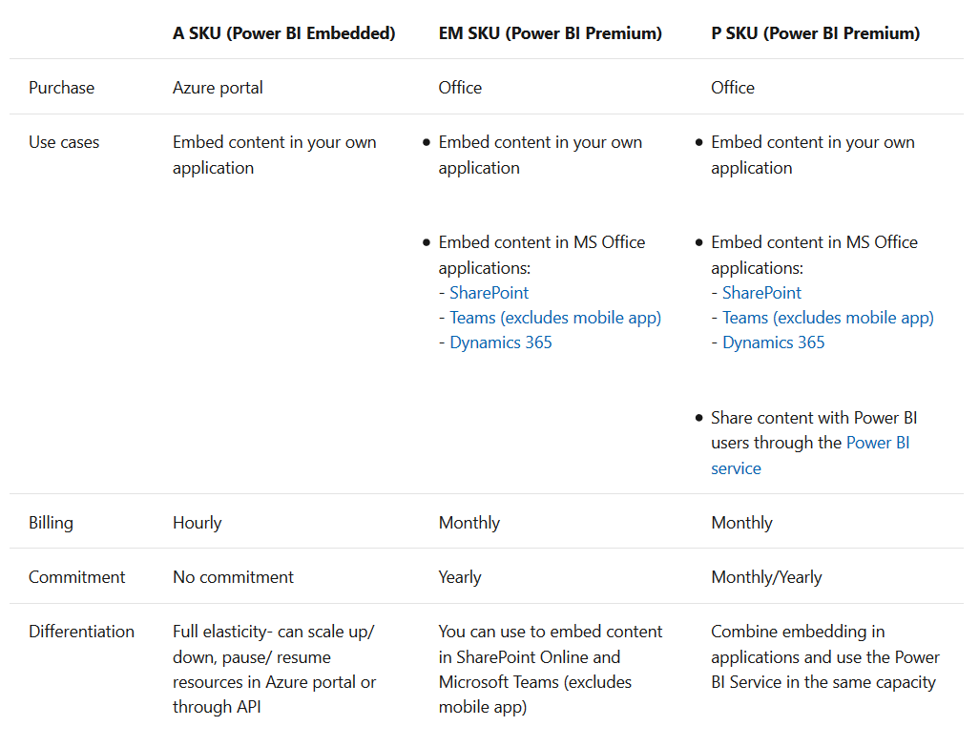
Capacity SKUs differences: A vs EM/P
Embedded
Embedding

Slide 20
Capacity SKUs differences: A vs EM/P

Slide 21
Example: Power BI Report Server licensing
Premium subscriptions
Customer is subscribed to two P1 Premium nodes
Each P1 node includes the right to run Report Server on up to eight cores
Thus, the customer is able to deploy Report Server on up to sixteen cores
Report Server deployment
RS
RS
RS
Server 1
4 physical cores
Server 2
2 virtual cores
Server 3
10 physical cores
+
+
3 Report Server instances across 16 total cores
RS
Report Server instances

Slide 22
Power BI Desktop
Narisorn Limpaswadpaisarn

Slide 23
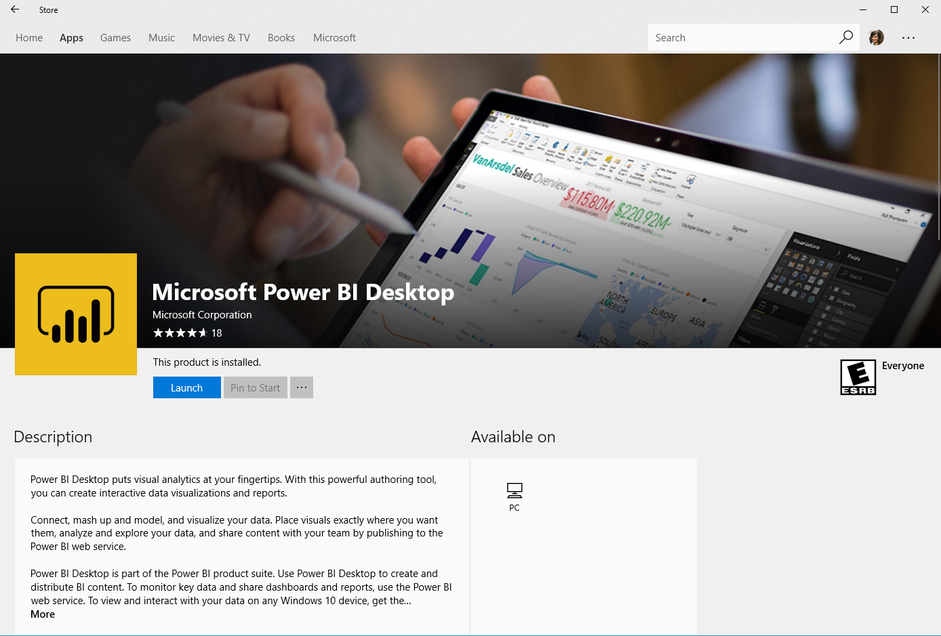
Download Power BI Desktop
Go to https://powerbi.microsoft.com/en-us/desktop/
Click Download Free (for 32bit version go to Advance download options and choose the file that is not x64)
Accept an agreement and install
If you download from Windows Store you will get monthly update (64-bit only) https://aka.ms/pbidesktop
If your Microsoft Office is 64-bit, please download 64-bit version.
For Mac, may need to run in Bootcamp or parallel

Slide 24
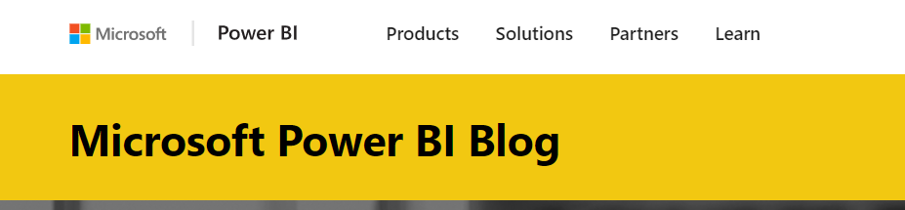
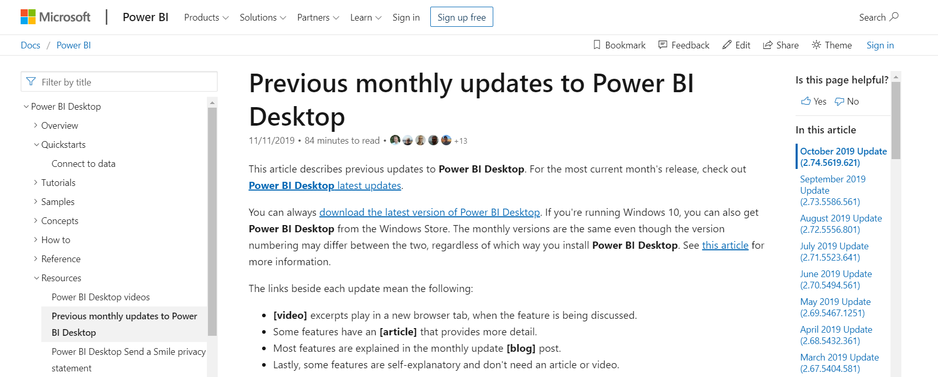
Power BI blog & Version releases
For the latest announcement https://powerbi.microsoft.com/en-us/blog/
If reverting to previous releases https://docs.microsoft.com/en-us/power-bi/desktop-latest-update-archive

Slide 25
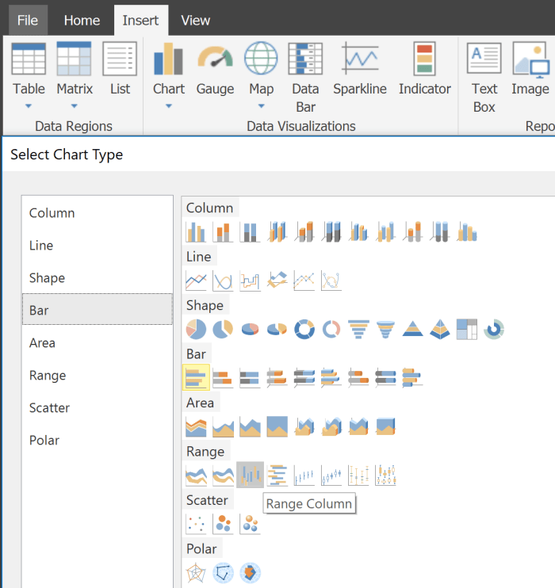
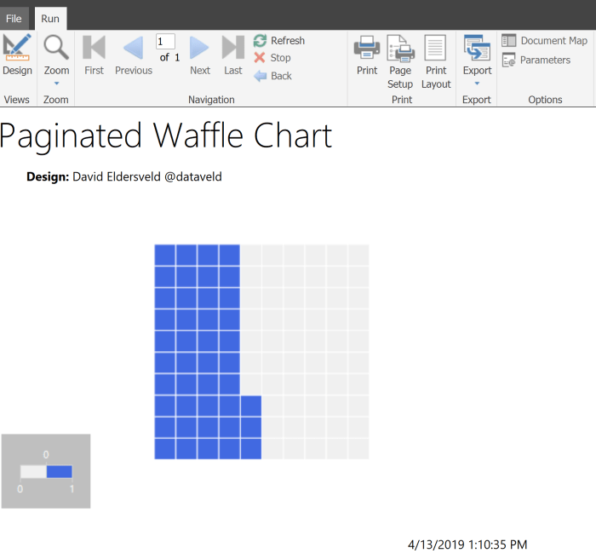
Paginated Report
https://docs.microsoft.com/en-us/power-bi/paginated-reports-quickstart-aw
This is capabilities from SSRS, can connect data source like Oracle, Teradata, SQL Server, SSAS etc.
File type is .RDL, can upload to Power BI Services (by Get Data) or publish directly
More printable friendly format, preview report in HTML format is available, export in Excel or PDF
Need to do in Power BI Report Builder (download here https://www.microsoft.com/en-us/download/details.aspx?id=58158)
Need connection string to connect to data source https://docs.microsoft.com/en-us/sql/reporting-services/report-data/data-connections-data-sources-and-connection-strings-report-builder-and-ssrs?view=sql-server-2017
Supports XMLA endpoints to provided access to Analysis Service engine
Supports XMLA endpoints to provided access to Analysis Service engine
For Power BI Premium Only. For SSRS please use normal report builder

Slide 26
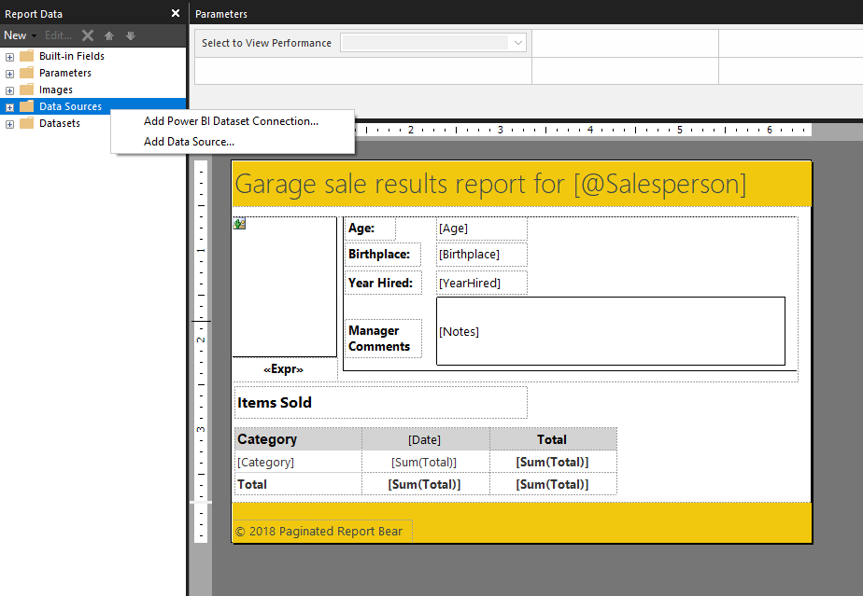
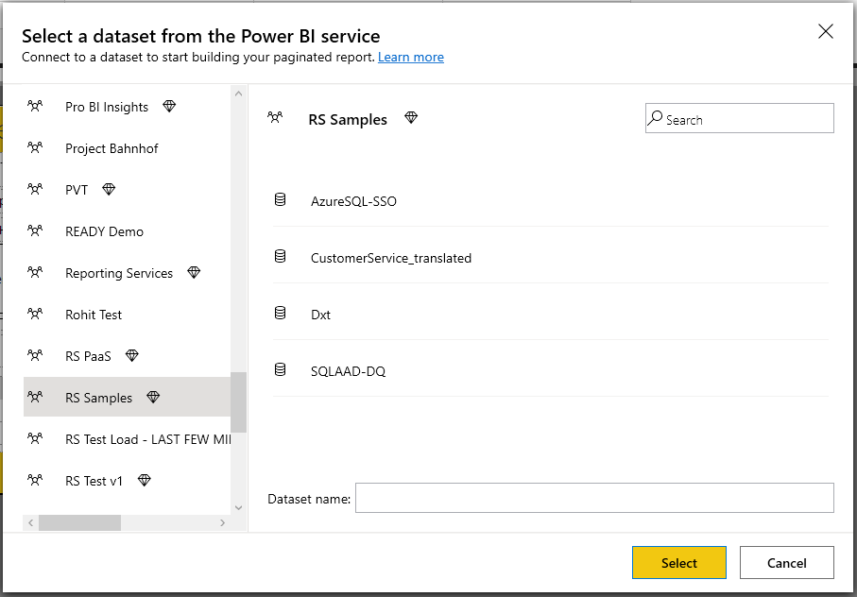
Paginated Report
This .RDL supports publish to Premium workspace only (not SSRS)
Pro users can add multiple data sources in a report, both local and Power BI dataset from cloud locally (both XMLA endpoint and non-XMLA, premium or non-premium)

Slide 27
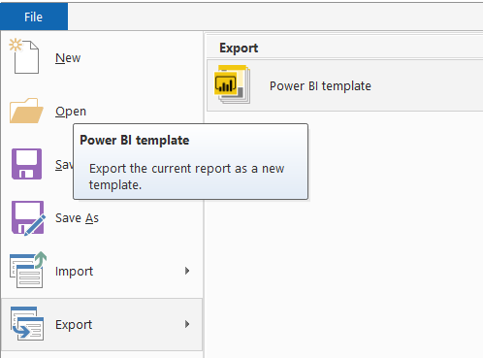
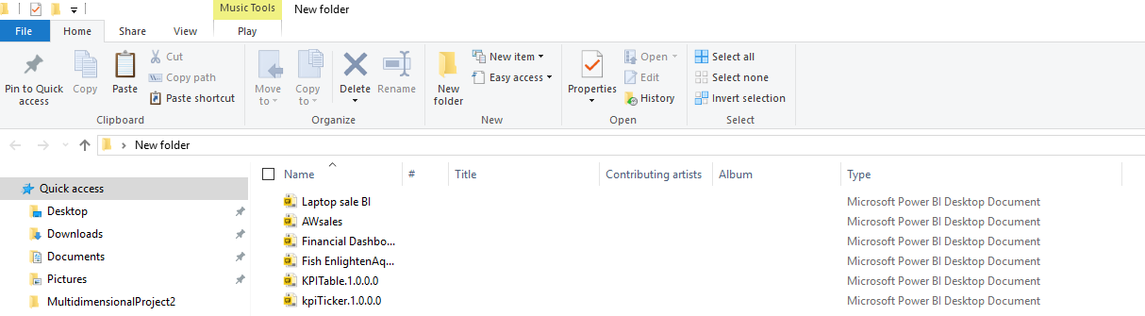
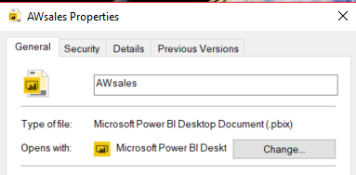
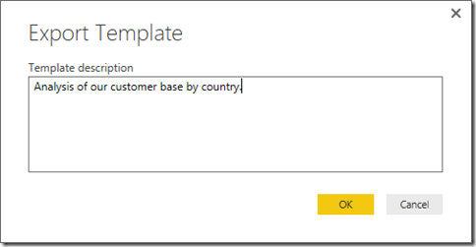
File types
Before upload to the cloud, we can create dashboard by Power BI desktop or MS Excel Power View with Power Pivot
For Power BI desktop, editor file is in .pbix extension, that you can share.
You can export template file in .pbit, share template that store Report (page, visuals), Data model definitions (relationship, measure, schema) and Query parameter to share others
Need the raw data in order to see data (If done with Excel, Access, CSV)
For DB, if you have right to connect you can see data and dashboard

Slide 28
File types
.pbix file can store things such as data, query parameters, visuals etc.
.pbit is the same but not row of data imported from tables in external data sources (size will smaller than .pbix)
.pbit is good for sharing to many different reports that has the same schema
Example, you have 10 different customers with 10 SQL servers, but same schema and you want to do the same kind of report visual and template
Both won’t store Data source credentials so you may need to specifies again when doing on-premise gateway
.RDL file is built from Power BI report builder to be paginated report

Slide 29



Tabs
We have 3 tabs that is Report, Data and Relationship (modeling view)
Report: is the dashboard tab that we want to make any graph
Data: is the table that we loaded from the raw file or DB
Relationship (modeling view): Show common column link between tables, suit for more complex relationship and multiple layouts (like 100 tables dataset) you can set pages on this relations as well

Slide 30
Shape data into the format and structure you need
Common data-shaping tasks
Remove rows
Rename/Remove tables and columns
Change a data type
Delete Relationships
Pivot columns and group rows
Modify a table name
Identify and fix errors
Merge or append queries to combine data from multiple queries into a single query
Extract week day, month name, hour from date/time values
Transform data to fit your needs using intuitive UI
Select data for inclusion
Cleanse data and remove errors
Precisely tune the query step sequence: re-order, add, edit or delete steps as needed
Modify data types to support specific calculation requirements
Very powerful for advanced scenarios such as Mashups
Run R scripts
Shape and combine data

Slide 31
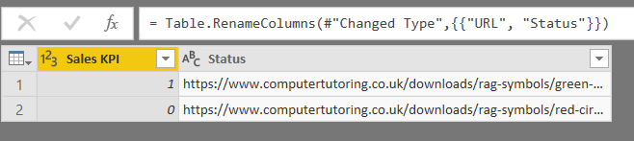
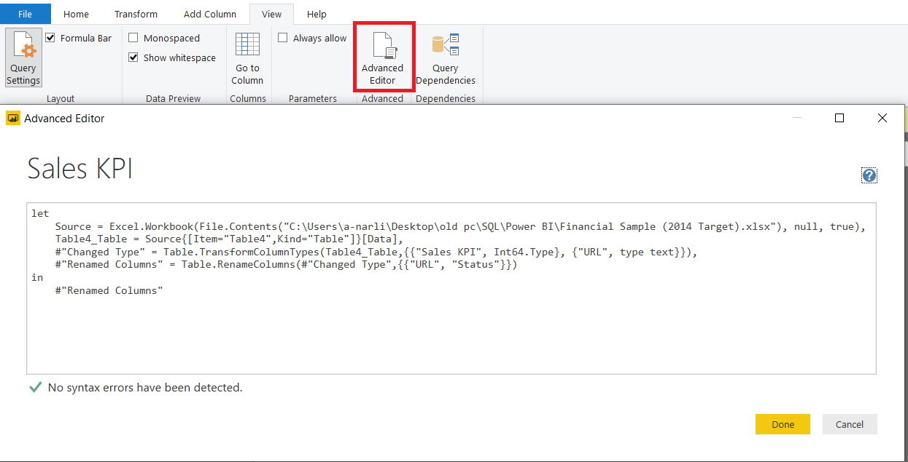
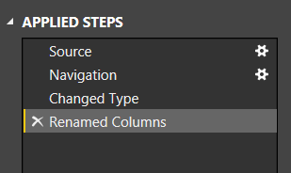
M Query Language
In each operation (merge, replace, change type etc.) that we used earlier in Power Query is adding a line of M Query language
Most of the time we do GUI, but for advance setting or reusing code we use M
M language can store SQL, Python, DAX (SSAS) and MDX (SSAS) inside M Query.
You can view or edit using M language using Advance Editor
Match step by step between GUI and Code

Slide 32
DAX (Data Analysis Expressions)
https://docs.microsoft.com/en-us/dax/data-analysis-expressions-dax-reference
When we create Measures, 90% help from xVelocity (VertiPaq) engine, 10% from DirectQuery
Distill your data into bite-sized insight
Can use with Power BI, Power Pivot, SSAS Tabular, Azure Analysis Services
Aggregations: Good for turning many values into one result like Total annual Sales
Filtering: Optimized to slide and dice your data based on filters
Support for historical analysis, KPI (easier and less code than using T-SQL)
Works with column and tables instead of rows or cells
Considerations
Is not good at Operational Reporting (OLTP like listing details in Sales order, Time sheets) because it design for aggregate summary of data (OLAP)
More column in the table, less performance
Not good for many to many relationship, few transaction tables with some dimension is ok
https://www.microsoftpressstore.com/articles/article.aspx?p=2449192
Prev-Year Total Sales :=
CALCULATE(SUM([Amount]), SAMEPERIODLASTYEAR(‘Date’[Datekey]))
Notes:
OLTP = Online Transactional Processing
OLAP = Online Analytical Processing
VertiPaq = “xVelocity in-memory Analytical Engine.”

Slide 33
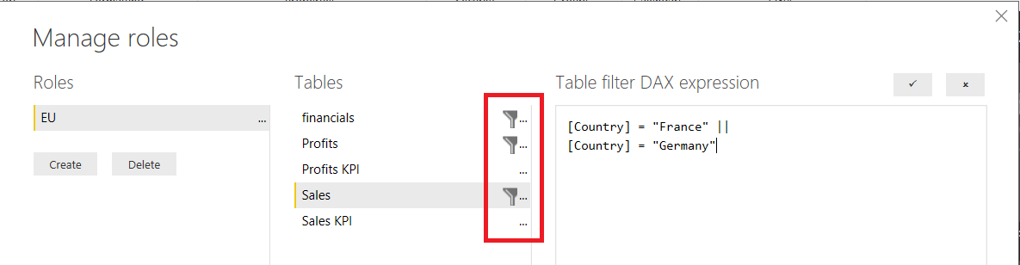
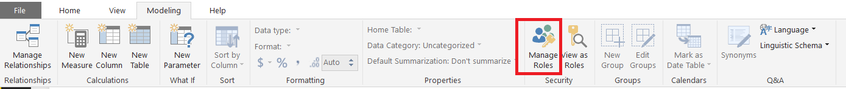
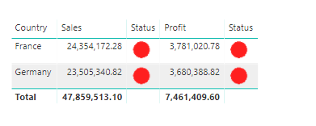
Row-Level Security (basic)
https://docs.microsoft.com/en-us/power-bi/service-admin-rls
Block viewing some specific data from specific roles in this case we want EU to see only EU (Only supports Import and DirectQuery connection). Analysis Services Live connection is not supported and should be done in Analysis Services model.
At Dashboard, click Manage roles
Then Create the name for the roles (EU), click select all tables you want to filter (…) then add DAX expression below and click save
Click View as role to test the result
[Country] = "France" ||
[Country] = "Germany"
OR ([Country] = "France", [Country] = "Germany")
[Country] IN {"France", "Germany"}

Slide 34
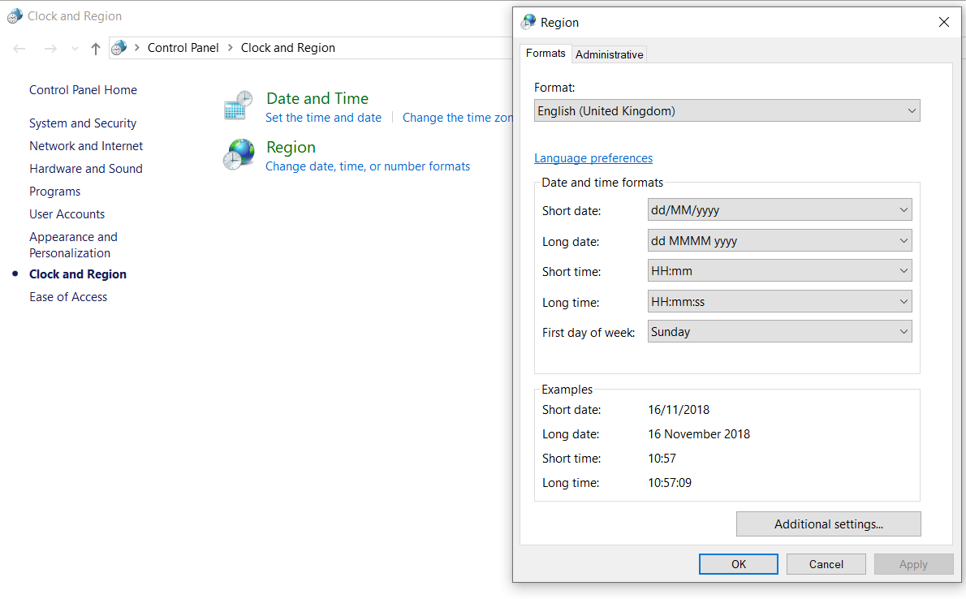
Date format settings
Normally the date format is English(US), which is M/d/yyy or MM/dd/yy
There is only 1 variation of dd-MMM-yy
This format for Power BI will reference from Windows clock system
If you want something like dd/MM/yy you need to set in Control Panels
Type “Change the way dates and lists are displayed” in Windows search.
Choose format to English (United Kingdom).
If we choose Thai -> year will be Por Sor (พศ)

Slide 35
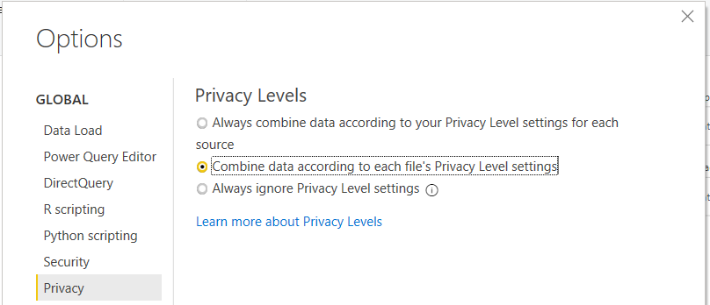
Privacy Levels
https://docs.microsoft.com/en-us/power-bi/desktop-privacy-levels
You can set isolation level between data sources to be prohibited when combining data such as merge the column between public source with private in Power Query
If we choose ignore, privacy is not considered when combining, performance may improve
It has Global and File level
or only this file that you’re opening

Slide 36
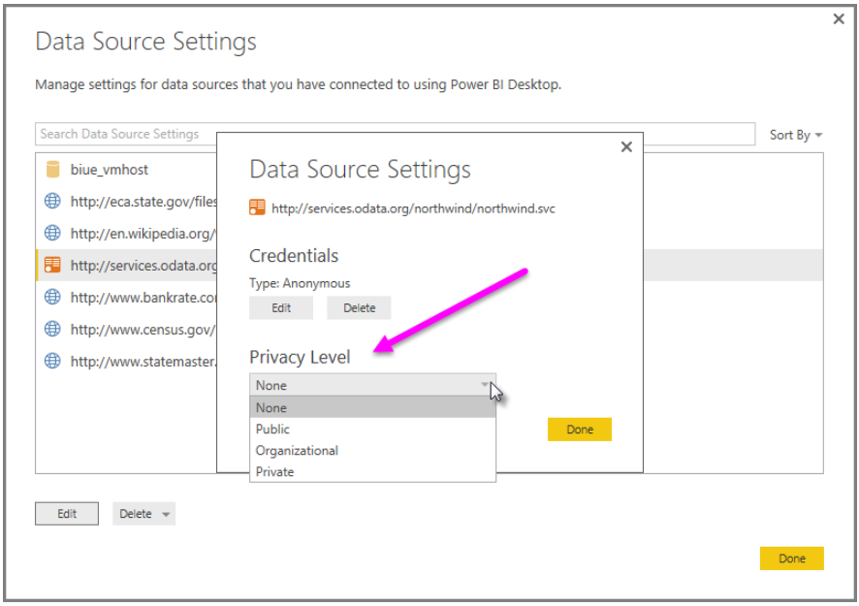
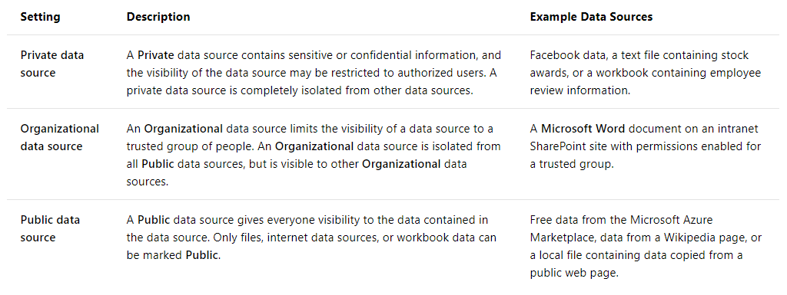
Privacy Levels
https://docs.microsoft.com/en-us/power-bi/desktop-privacy-levels
Set privacy level in data source settings

Slide 37
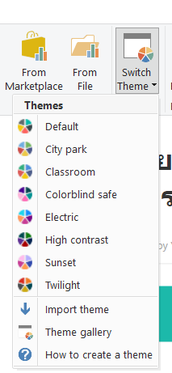
Switch Theme
https://docs.microsoft.com/en-us/power-bi/desktop-bookmarks
You can switch the color tone of your entire visuals by switching theme
At Report view, go to home -> Switch Theme
Select from existing or upload your custom in JSON format
This URL can help us with the color code and JSON format
https://powerbi.tips/tools/color-theme-generator/
https://powerbi.tips/tools/report-theme-generator-v3/
Color code with picture upload
https://html-color-codes.info/colors-from-image/
Or use easy color to .json creator
http://thememaster500.azurewebsites.net/

Slide 38
Sharing in Power BI
Narisorn Limpaswadpaisarn

Slide 39
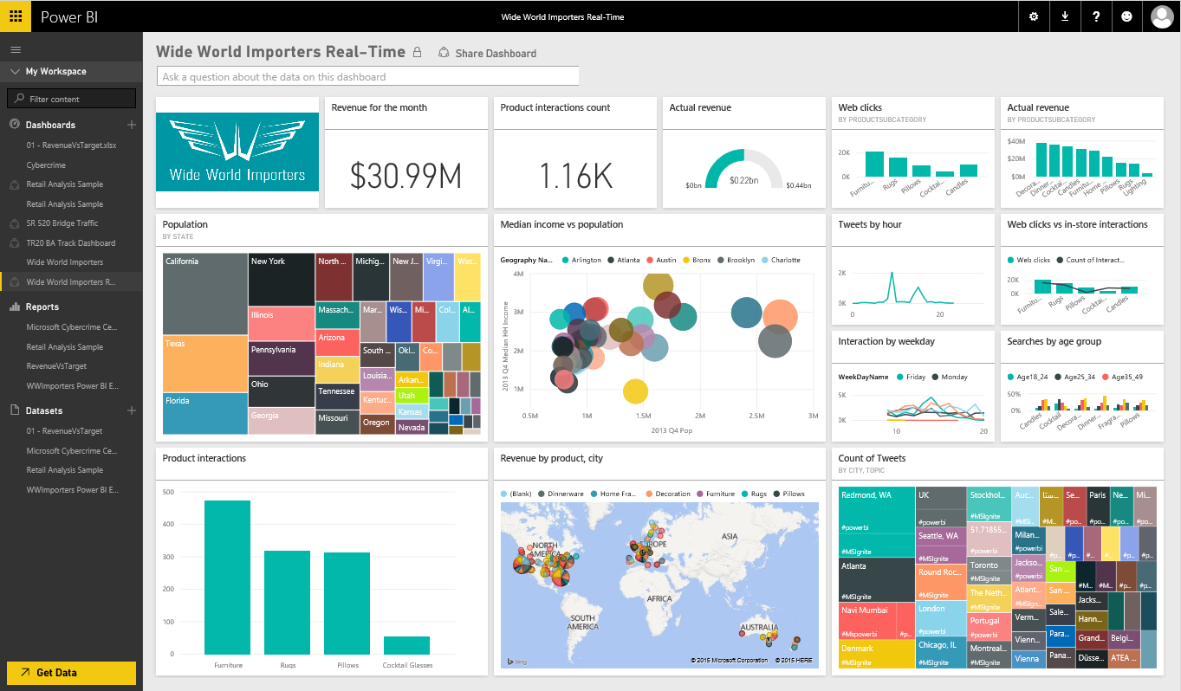
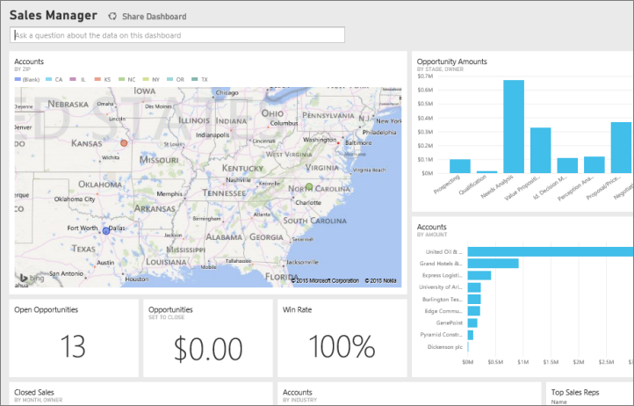
Publish, Collaborate and Share
Easily share dashboards and reports across your organization
Sharing can be controlled and enabled by IT using Office 365 groups
Changes to dashboards automatically sync across all users
Datasets for dashboards and reports reside in the group’s workspace
Publish to web (embedded code) that can be view by anyone on the internet
Publish to Power BI apps to your large organization audiences
Share target to Office 365 apps such as SharePoint Online or Microsoft Teams

Slide 40
Groups often used in Power BI
Security groups
Office 365 groups – mostly used for apps

Slide 41
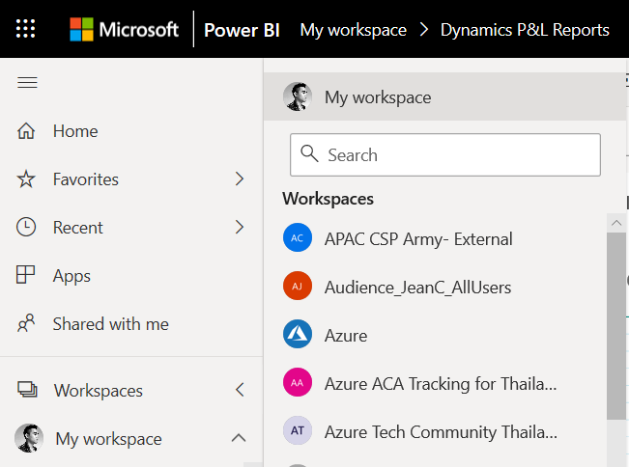
Publish to the App/My workspace
Workspace is a storage container of Dataset, Report and Dashboard also trigger Office 365 Group and SharePoint Online team site
Publish directly from the Power BI desktop
Groups workspace to the group dashboards
Can be view and edit among Office 365 Group members.
Admin can assign member to be Admin
Admin can disable member to edit content
Collaboration with Office 365 apps such as group conversation, calendar, sharing file on OneDrive for Business.
Must have Power BI Pro license.
Notes:
https://docs.microsoft.com/en-us/power-bi/service-publish-to-web#limitations

Slide 42
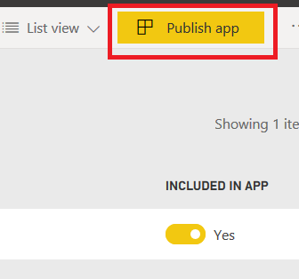
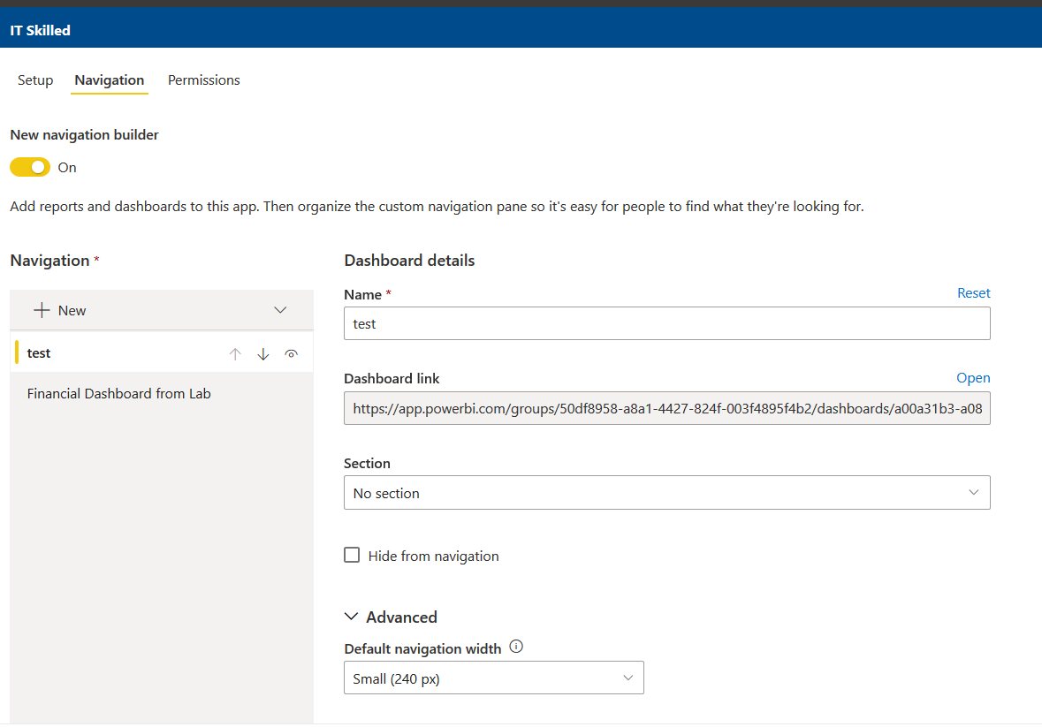
https://docs.microsoft.com/en-us/power-bi/service-create-distribute-apps
Publish app
App model replaces Organizational content pack for many audiences to view
Publish to app for wider range of users in your organization. Can connect to external services like Google Analytics, Marketo, Dynamics 365 etc. After publish you can Update or Unpublish
App is a collection of dashboards, reports and Excel workbooks that are form App Workspace (can’t create in My workspace)
Role Level Security still applied
You can staging update data from App workspace before update to App to see changes.
You still can manage who can see your app (user/group)
Must have Power BI Pro license
Can use with Premium capacity for Free Power BI user
Admin can give you a permission to install app automatically, pushing to all users

Slide 43
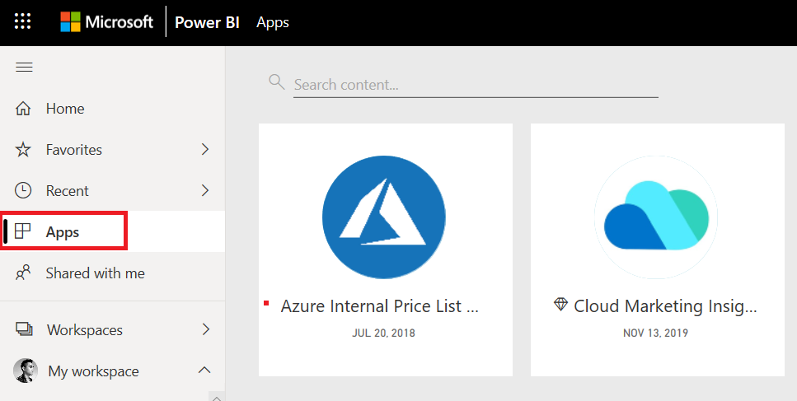
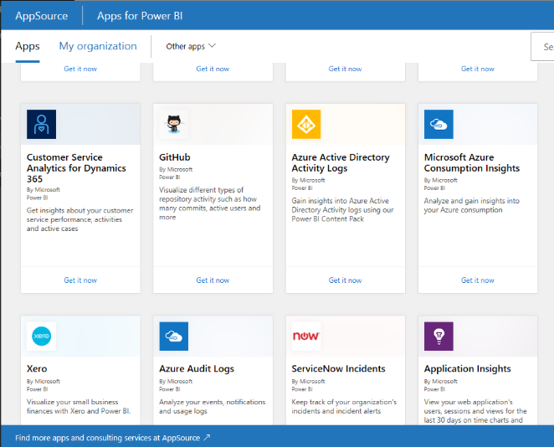
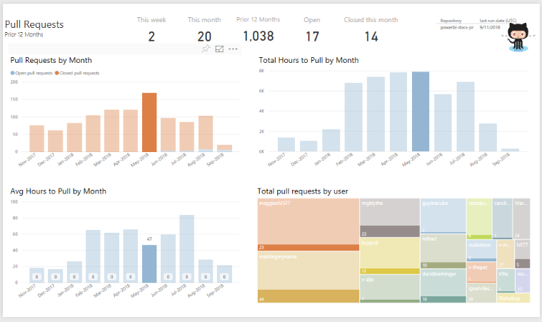
https://docs.microsoft.com/en-us/power-bi/service-create-distribute-apps
Publish app/App Source
You can get the apps that push in Apps
Send a direct link or find in Microsoft AppSource
In AppSource, we can find apps that let you connect to 3rd party services Ex. Use your GitHub account to download and create Dashboard, Report of your GitHub repo to see your Commit, Pull request statistics

Slide 44
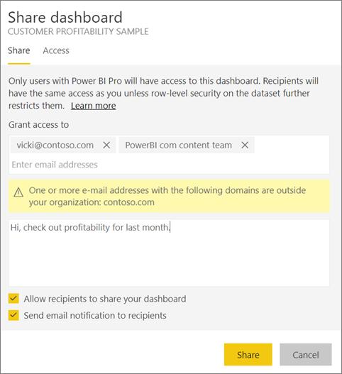
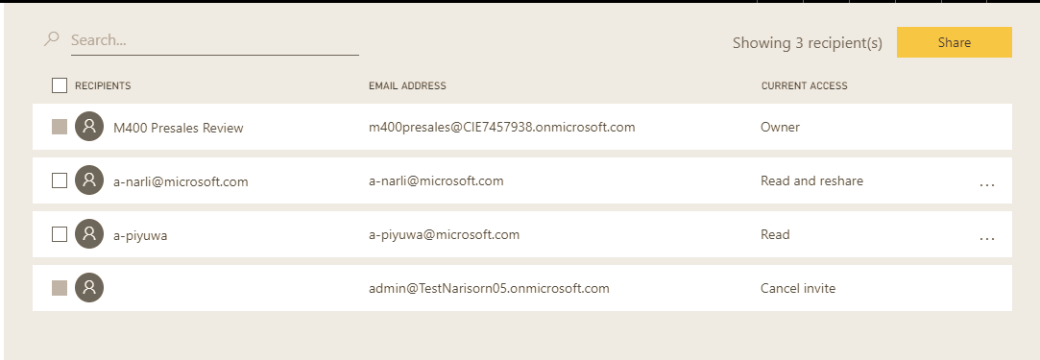
Share Power BI Report/Dashboard directly
Directly share to specified users or groups.
Can share to the person outside your organization.
Can’t share to free mail users.
It will create them as guest users in Office 365
Can view only or allow them to share to others
Recipients still required Power BI Pro license or assign to Premium capacity.
Row-level security still applied.
Can manage permission after sharing
For report, you can also filter some content first before share. By modified sharing URL.
?filter=tablename/fieldname eq value
https://docs.microsoft.com/en-us/power-bi/service-share-reports

Slide 45
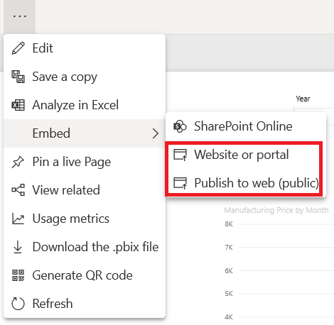
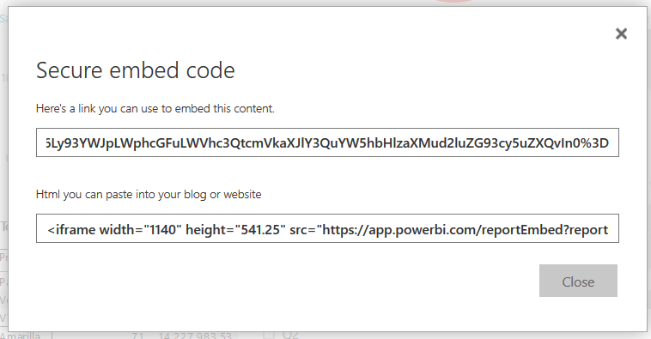
Publish to web or Embed in portal (report)
Publish to web (Public) that can be view by anyone on the internet (but no authentication used) So ensure that you have the right to share data. Viewers don’t need a license since there’s no authentication
Embed in Website or Portal (non-public) let you do on internal websites like web portal form cloud or on-premise like SharePoint 2019 then you can do URL filters or URL settings with HTML and JavaScript for manage the code which page to open. Viewer need Power BI Pro license (has authentication)
Power BI Admin can disable Publish to web (public) to specific group or entire organization in Admin settings.
Report that has Row Level Security, Analysis Services tabular host on premise, “R” visual are not supported
You must be the member who can edit.
Can’t do for the report someone shared directly to you
Data refresh 1 hour approx. or you can disable.
Modify resolution on iframe
Notes:
https://docs.microsoft.com/en-us/power-bi/service-publish-to-web#limitations

Slide 46
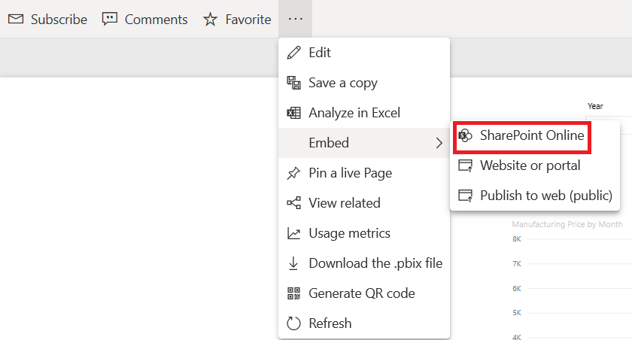
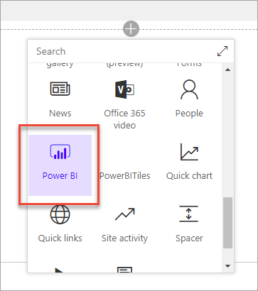
Publish to SharePoint Online (Report)
Publish to SharePoint to be visible for Office 365 group member.
To use it, you need to be Power BI pro.
Support SharePoint modern pages only.
Member of Office 365 group can view.
Users must have Power BI pro license.
Guest access still can’t view if they have licenses need to share dashboard from Power BI portal instead or use Publish to web method.
Latest web browsers are required.
Takes an hour to refresh.
Can use with Premium capacity for Free Power BI user to View.
Notes:
https://docs.microsoft.com/en-us/power-bi/service-embed-report-spo

Slide 47
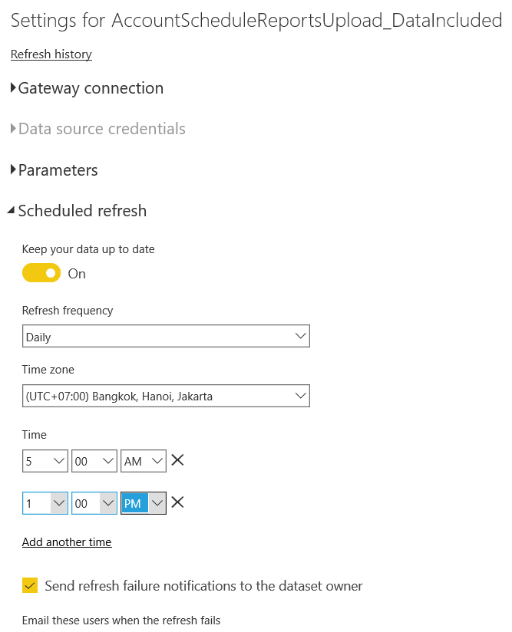
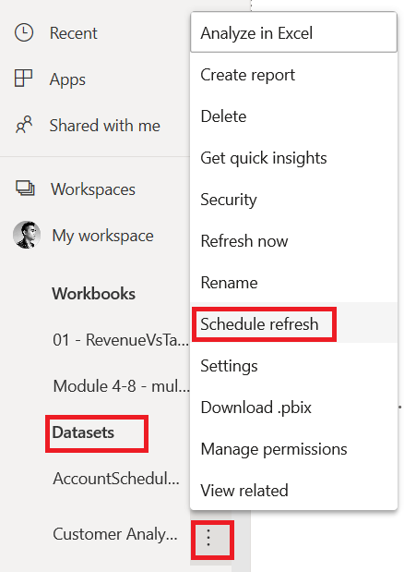
https://docs.microsoft.com/en-us/power-bi/service-gateway-onprem
Schedule Refresh the data
https://docs.microsoft.com/en-us/power-bi/refresh-scheduled-refresh
This is for connect to database scenario
Need to install Gateways either in your pc (personal) or server before (on premise)
At Dataset, click … and Schedule Refresh
Then choose your gateway and refresh frequency

Slide 48
Consideration
Row Limit (in Power BI Service)
When not using DirectQuery is about 2 billion rows (1,999,999,997 rows)
When using DirectQuery is 1 million rows
Column Limit (in Power BI Service and Desktop)
About 16,000 Columns – No. of tables used across all entire dataset since the system will use an internal row number column per table

Slide 49
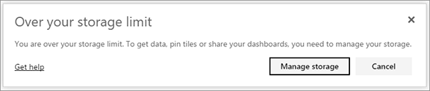
Data Capacity and Refresh
Storage
Free has 1 GB storage and Pro users have a maximum 10 GB storage
Pro users can create App/Group workspaces, with a 10 GB data storage each
Power BI Premium has 100 TB
Individual Dataset Size Limits (.pbix)
1 GB limit for Pro and up to 10 GB limit for Premium
Pictures you upload
You pin items for 2 reports that are 2 dataset, count both
Max automatic refreshes per day
8 times for Pro, 48 times for Premium
App workspace in Premium capacity doesn’t count toward the storage of a Power BI Pro user
*Premium can refresh up to 12GB
*EM/A SKUs are not recommended for refreshing very large dataset
Premium SKU | Size of .pbix
P1 | <1- 3 GB
P2 | < 6 GB
P3 – P5 | Up to 10 GB

Slide 50
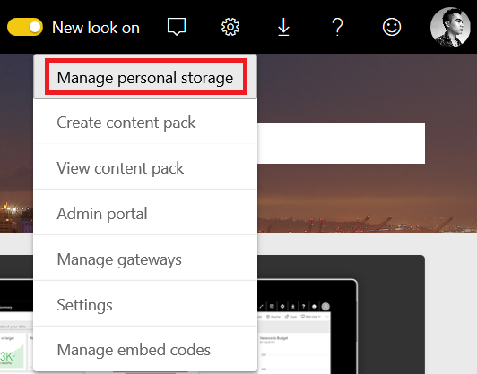
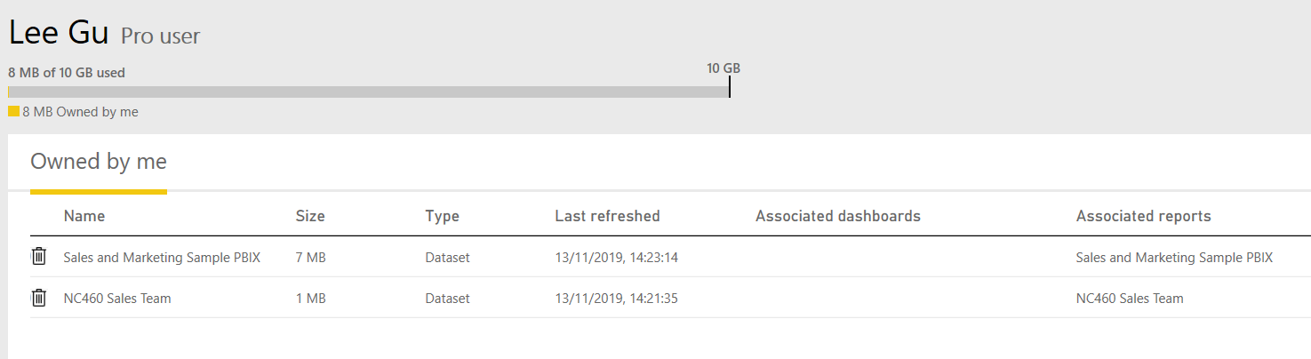
Data Capacity
Owned by me
You upload report and dataset to the services including services dataset such as Salesforce and Dynamics CRM
Owned by others
Other shared these reports and data set with you

Slide 51
Power BI Services
Narisorn Limpaswadpaisarn

Slide 52
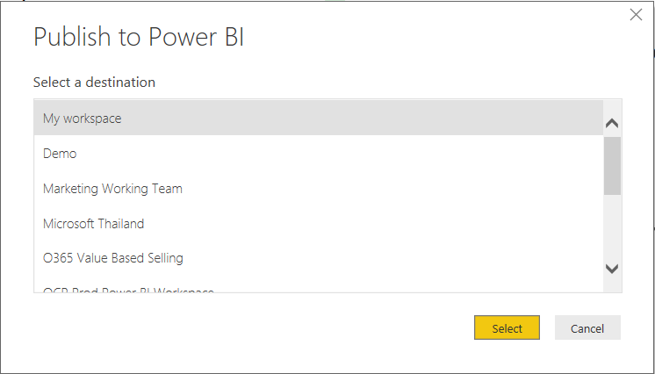
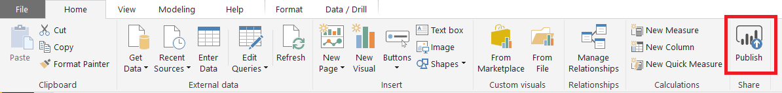
Publish
https://docs.microsoft.com/en-us/power-bi/desktop-upload-desktop-files
Click Publish and select your workspace
All visualizations and dataset will upload to cloud (import mode)
If you make changes on your dataset or graph click “Publish” to replace an existing data on cloud
If you have 2 or more datasets in cloud the same name as Power BI desktop file, publish could fail make sure you have only one or rename it both dataset and .pbix file.

Slide 53
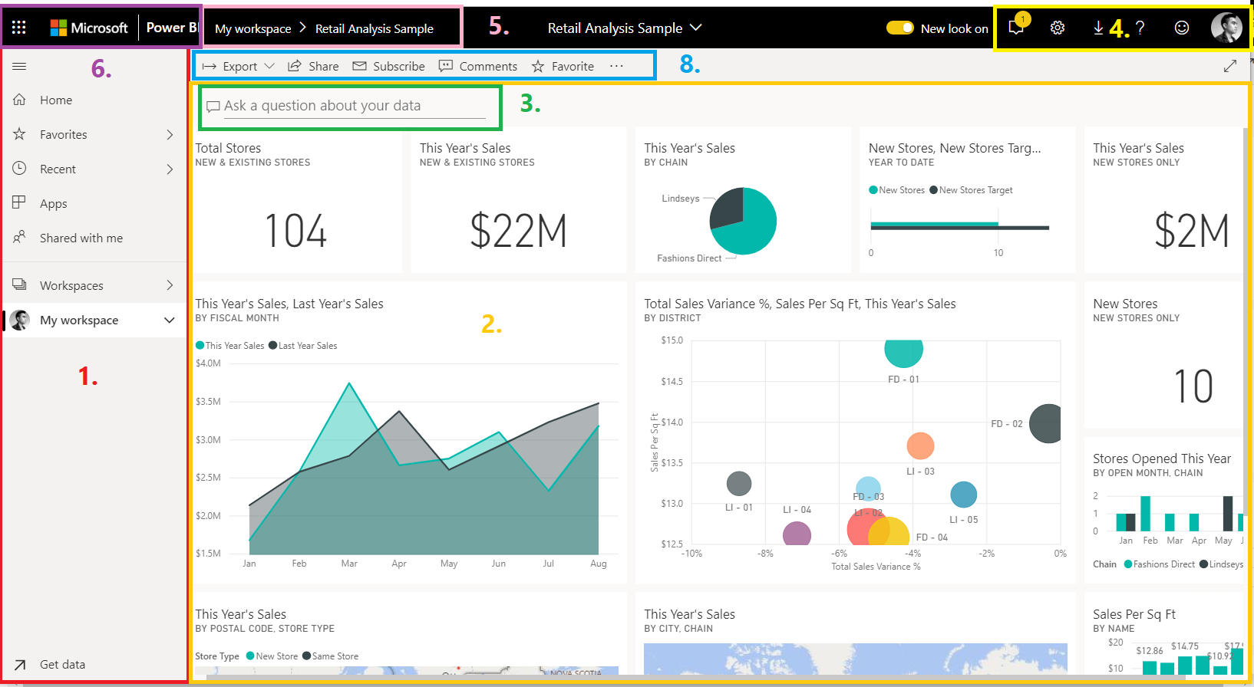
Power BI Service (SaaS)
When we publish from Power BI Desktop -> It’s goes to Power BI Services
The main features of your Power BI service UI are the following:
1. navigation pane (left nav)
2. canvas (in this case, dashboard with tiles)
can add something image, video, web content
3. Q&A question box
4. icon buttons, including help and feedback
5. dashboard title (navigation path, aka breadcrumbs)
6. Office 365 app launcher and Power BI home button
8. Labeled icon buttons

Slide 54
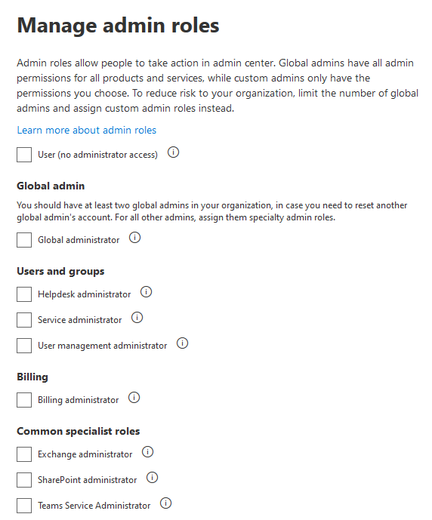




Admin Portal
Need Power BI service administrator role or Global administrator role
https://docs.microsoft.com/en-us/power-bi/service-admin-role
Have privilege to do administrative things such as Audit logs, Set Classification tags or Capacity settings
https://docs.microsoft.com/en-us/power-bi/service-admin-portal
https://docs.microsoft.com/en-us/power-bi/service-admin-auditing

Slide 55

Check service status
Go to https://powerbi.microsoft.com/en-us/support/

Slide 56


Featured/Favorites
https://docs.microsoft.com/en-us/power-bi/consumer/end-user-featured
At selected dashboard, click set as featured
Every time when you open Power BI portal you will see that as a default dashboard
You will replace this one by “Set as featured” to another dashboard.
Click Favorite for dashboard that has frequent use to store in favorites tab
At Favorites, click the star icon to remove form feature

Slide 57





Alert (Dashboard)
https://docs.microsoft.com/en-us/power-bi/consumer/end-user-featured
Notify on values when above or below the threshold
Use with KPIs, Cards or Gauges on numeric values
Click … and Manage alerts (24 hr. or every hr. time frame)
Supported on Pin tiles dashboard, not Pin Live Pages
Can integrates with Microsoft Flows for more actions

Slide 58


Email Subscription
https://docs.microsoft.com/en-us/power-bi/service-report-subscribe
Getting up to date, send email snapshot of report or dashboard and sent to everyone
Power BI Pro user to create subscription, Pro user to receive mail (unless Premium capacity)
At Dashboard, click letter icon, you can set frequency weekly, daily or after data refresh
After create subscription, you can get back and select Run Now to test (have some delay)
- There may be some delay, you can set differential time
- One Report/Dashboard can have many subscriptions
- Email subscriptions don’t support most uncertified custom visuals
- Email subscriptions don’t support R
- Rename report page need to re-create subscription
- RLS tied with the tile, that tile won’t display
- RLS tied with the dataset, you can’t be able to create subscription
- Tiles like video, web, streaming are not supported
- Can’t subscribe to email that outside organization
- Email size settings may cause error if image is large

Slide 59


Email Subscription
https://docs.microsoft.com/en-us/power-bi/service-report-subscribe
For RLS or Live Connection Report/Dashboard, each workspaces members need to enable subscribe by themselves
You can’t send to other’s recipients
Using Power Automate (with subfolder in your Inbox) you can forward to other recipients
But recipients will see the same visuals as yours without RLS applied
Flow’s quota per month will be consumed

Slide 60



Email Subscription
https://docs.microsoft.com/en-us/power-bi/service-report-subscribe
Email uses the language set in Power BI language settings
You can manage email subscription here under subscription tab

Slide 61

Check & Turn on Q&A
At Dashboard, click … and then Settings
Check box, turn on Q&A search box to allow Q&A box in the dashboard for users
Tile flow is useful when you drag any tiles in dashboard, it will auto align the rest to the top-left
Adjust Data classification on this page as well
Q&A is now supported in Power BI Desktop
Q&A is not supported when you
Applied Row Level Security (need to remove since in Power BI Desktop) or use Direct Query method to the Dataset

Slide 62


Q&A (Pro & Premium only)
https://docs.microsoft.com/en-us/power-bi/consumer/end-user-q-and-a
- At dashboard, Begin by asking “Show…” For example:
Show <table>
Show <aggregate function><numeric column>
Show <measure> by <column>
Show <column> where <column> is before <date value>
Show <measure> where <column> is before <date value> sorted by <measure>
Show <measure> where <datetime column> is [this | last] [year | month | hour | minute | second]
- Optionally, Q&A responses can be:
Customized by using the Visualizations or Fields panes
Pinned to the dashboard

Slide 63


Q&A (Pro & Premium only)
https://docs.microsoft.com/en-us/power-bi/consumer/end-user-q-and-a
Edit page in report, insert Q&A with using known words (separate by comma for adding more) that user may ask frequently
When pin the page to dashboard user can type the name to quickly show the page

Slide 64


Q&A (Pro & Premium only)
https://docs.microsoft.com/en-us/power-bi/consumer/end-user-q-and-a
Edit suggest questions, to help user see some sample questions
At Settings -> Datasets and select data set and add questions

Slide 65



Quick Insights
https://docs.microsoft.com/en-us/power-bi/service-insights
At Dataset, click … and then Quick Insight
The system will analyze your Dataset and then result some visual tiles that show trends, outliers or correlation between your data
You can still choose each tiles and pin to Dashboard
Some insight is good, but some is not depending on your column naming
DirectQuery dataset is not supported, only data uploaded to Power BI service

Slide 66



Dashboard Theme
https://docs.microsoft.com/en-us/power-bi/service-dashboard-themes
Dashboard theme can be set and not relying from the report
Visuals in dashboard level will use theme color, but report level still the same
If visuals (theme report) is pin, you can choose to kept the theme or use the dashboard theme
Not supported for pinned live, SSRS tiles, iframe tiles, images or workbook tiles
Theme can be seen at Power BI mobiles app but not edit
Can upload .json file just like report theme

Slide 67
Report vs Dashboard
Narisorn Limpaswadpaisarn

Slide 68

Terms
Data Source = What Power BI import or connected to like Excel files, SQL servers, Azure SQL database, Online services or table from Wikipedia.
Dataset = Once you import or connect one or more data sources, Power BI will create dataset (under .pbix file). Dataset can be renamed, refreshed, explored and removed. Dataset also include DAX calculation that we used.
1 dataset
can be used in many different reports (but report has a single dataset)
can be used over and over in one or in many workspaces
visualizations from that 1 dataset can display on many different dashboards

Slide 69






Report vs Dashboard
When re-publish report to Power BI services, report gets update but tiles that you pinned to the dashboard is not linked and not updates
When publish from Power BI Desktop it goes to Power BI Services
It will convert to Report, also Dataset is uploaded
To make it become Dashboard, need to Pin the whole Report or pin some tiles in the report
Report has many pages to select, dashboard need to pin each page from the report and scroll down.
1 Dashboard may contain different tiles from different reports
Report can edit, add more visualizes, graphs and can filter
Dashboard isn’t built for slicing and dicing, it’s a high-level view of KPI for example a day-to-day view and navigation point to the detail reports, but it can set an alert on data
Dashboard Theme can be separates from Report Theme
Microsoft Edge
Internet Explorer, 10 or 11
Chrome desktop, latest version
Safari Mac, latest version
Firefox desktop, latest version

Slide 70





Report
Can make from scratch, imported with dashboards that your team shared to you or connect to datasets like you can connect Excel that has Power View sheets, or SaaS Apps, Power BI Desktop that pre-built reports.
Report can Drill-through or Drill down or Bookmark view change to effect visual
Multi page views
See more detail than Dashboard
Can publish to web or embedded to web or SharePoint online
1 report
is contained in a single workspace
can be associated with multiple dashboards within that workspace (tiles pinned from that one report can appear on multiple dashboards).
can be created using data from one dataset. (the slight exception to this is that Power BI Desktop can combine more than 1 dataset into a single report and that report can be imported into Power BI)

Slide 71





Dashboard
From your creation or someone share to you
Use for seeing things in high-level, business monitoring
Set as featured dashboard (landing page) to view anytime
One-page view
National language Q&A and Data Classification
Add more non-data related tile such as Web content, Image, video or Streaming data
Set for email alert such as some amount goes above the threshold
Real time monitoring with REST API (PUSH method) can use with Azure Stream Analytics
1 dashboard
is associated with a single workspace
can display visualizations from many different datasets
can display visualizations from many different reports
can display visualizations pinned from other tools (e.g., Excel)

Slide 72
Securities and Identities
Narisorn Limpaswadpaisarn

Slide 73
Data Security (in cloud)
https://docs.microsoft.com/en-us/power-bi/whitepaper-powerbi-security
In transits – Always in HTTPS encrypted
At rest, it depends (mostly Blob storage and Azure SQL) – such as
Datasets
Credentials to connect to the data sources
Metadata is the report/dashboard layout
Visual cache stores data to render that visuals
** Enable RLS makes varieties of cache versions
The keys are automated, and Microsoft Staff can’t access
Encryption keys on Blob storage are kept by Microsoft
Azure SQL DB uses Transparent Data Encryption managed by Microsoft
Encryption keys are also kept in On-premise Gateway if there is a connection
Encryption keys are also encrypted by SQL Data Movement Role for Cloud-based data sources

Slide 74

Data Security (in cloud)
https://docs.microsoft.com/en-us/power-bi/whitepaper-powerbi-security

Slide 75


Data stored
You can check here

Slide 76
Security
User Identity – AAD, MFA
Data Security
Compliance & Market availability
Content protection - RLS

Slide 77
Azure Active Directory
Like Microsoft Azure, Dynamics 365, Office 365 for Identity
Use AD connect (with SSO) to on-prem to cloud authentication
Managed Identities (Password auth)
Federated Identities (ADFS or 3rd Party)
All users need to have Power BI license (Free or Pro)
Notes:
https://docs.microsoft.com/en-us/power-bi/service-publish-to-web#limitations

Slide 78

Azure Active Directory
Global Administrator can check this app
You can access in Office 365 admin center or https://aad.portal.azure.com
Enterprise Application -> Search for Power BI
Notes:
https://docs.microsoft.com/en-us/power-bi/service-publish-to-web#limitations

Slide 79

Multi-Factor Authentication
Enabled through Azure Portal (need Office 365 or AD Premium license)
Azure MFA supports Phone call, text to phone, Notifications through app and verification code from mobile or hardware token.
Set up at https://aka.ms/mfasetup
Need Microsoft Authenticator app to your devices
If you have ADFS, you can have 3rd party on-premise MFA for your tenant
Notes:
https://docs.microsoft.com/en-us/power-bi/service-publish-to-web#limitations

Slide 80


Intune supported
Enforced through Power BI Apps for MAM/MDM cloud solution
With Microsoft Intune, iOS and Android supported
PIN code to access Power BI Apps (with failed attempted)
Data encryption, Selective data wipe, restrict share/screenshot/copy/jailbreak
Notes:
https://docs.microsoft.com/en-us/power-bi/service-publish-to-web#limitations

Slide 81

Conditional Access
https://docs.microsoft.com/en-us/azure/active-directory/conditional-access/overview
Limit access to specific person, Office 365 Group or even some AD roles
Result in limited access to domain-joined, register Intune or need to do MFA
Which IP ranges?
Which devices?
This group?
If no VPN, MFA required?
Notes:
https://docs.microsoft.com/en-us/power-bi/service-publish-to-web#limitations

Slide 82


Trusted location
https://docs.microsoft.com/en-us/azure/active-directory/conditional-access/location-condition
Create your trusted location (your local networks)
Notes:
https://docs.microsoft.com/en-us/power-bi/service-publish-to-web#limitations

Slide 83


Conditional Access
https://docs.microsoft.com/en-us/azure/active-directory/conditional-access/overview
Policy name, Assignments, Access controls and Enable policy
Notes:
https://docs.microsoft.com/en-us/power-bi/service-publish-to-web#limitations

Slide 84

Conditional Access Assignment
https://docs.microsoft.com/en-us/azure/active-directory/conditional-access/overview
Policy name – name the policy
User and Group – select who affects this policy choose between guest user (outside organization), Directory roles (admin roles) and Users and groups
Cloud Apps – Already selected Power BI. You can include others
Notes:
https://docs.microsoft.com/en-us/power-bi/service-publish-to-web#limitations

Slide 85


Conditional Access Assignment
https://docs.microsoft.com/en-us/azure/active-directory/identity-protection/howto-user-risk-policy
Conditions
Sign-in risk -> Indicates status to be tagged
Devices platform choose to allow which platform can consume Power BI services
Notes:
https://docs.microsoft.com/en-us/power-bi/service-publish-to-web#limitations

Slide 86

https://docs.microsoft.com/en-us/azure/active-directory/conditional-access/location-condition#location-condition-configuration
Conditional Access Assignment
Choose locations
Any location – will accepts all IP addresses
All trusted location – will accept both MFA trusted IP (if set) and trusted locations
Selected location – You need to choose which trusted location and MFA trust IPs to be included in this condition
Notes:
https://docs.microsoft.com/en-us/power-bi/service-publish-to-web#limitations

Slide 87

Conditional Access Assignment
https://docs.microsoft.com/en-us/power-bi/desktop-gridlines-snap-to-grid
Choose client app that count in this policy
For ActiveSync – this is in the case of access Exchange on mobile devices
Other clients – such as older Office client, POP3, IMAP, SMTP or ACS
Notes:
https://docs.microsoft.com/en-us/power-bi/service-publish-to-web#limitations

Slide 88

Conditional Access Assignment
https://docs.microsoft.com/en-us/power-bi/desktop-gridlines-snap-to-grid
Choose device state that will exclude in this policy
Hybrid AD joined – Managed by Group policy or SCCM and register in Azure AD
Marked as compliant – Managed by Intune already
Notes:
https://docs.microsoft.com/en-us/power-bi/service-publish-to-web#limitations

Slide 89


Apply Row-Level Security
Go to https://app.powerbi.com/ and to the workspace that you published
At Datasets, click … and security
Add emails (people or group which is Security group) to the role that you create RLS since in Power BI Desktop, click Add and Save
Can be an Azure AD
- user account
- Security group
- Mail-enabled security group
*** Assign in groups will be more dynamics since when
user change role and move to another group permission is disabled

Slide 90

PowerShell for Power BI
https://www.powershellgallery.com/packages/MicrosoftPowerBIMgmt/1.0.410
Use this command to Install PowerShell module for Power BI
Library here https://docs.microsoft.com/en-us/powershell/power-bi/overview?view=powerbi-ps
Install-Module -Name MicrosoftPowerBIMgmt -Scope CurrentUser
Supports PowerShell Core or v3.0 that
has .NET 4.7.1 or above

Slide 91
Admin Control
via Power BI Admin Portal
Control who can do self-sign up
Control who can share content
Control who can export data
Control embed content, Power BI APIs
Control who can install Power BI Gateway
Control who can create content packs
Control Dataflows
And more

Slide 92


https://docs.microsoft.com/en-us/office365/securitycompliance/search-the-audit-log-in-security-and-compliance
Audit log
- Power BI all users and admins activities https://protection.office.com/

Slide 93


Disable free Power BI sign up
For Office 365 Admin
Use PowerShell command
https://docs.microsoft.com/en-us/office365/admin/misc/power-bi-in-your-organization?redirectSourcePath=%252fen-us%252farticle%252fPower-BI-in-your-Organization-d7941332-8aec-4e5e-87e8-92073ce73dc5&view=o365-worldwide#BKMK_PreventJoining
https://powerbi.microsoft.com/en-us/blog/ability-to-disable-free-sign-ups-for-the-free-power-bi/
#sign in to Azure AD
$msolcred = get-credential
connect-msolservice -credential $msolcred
# set disable for free trial
Set-MsolCompanySettings -AllowAdHocSubscriptions $false
# check the status
Get-MsolCompanyInformation | fl AllowAdHocSubscriptions

Slide 94
Power BI Gateways
Narisorn Limpaswadpaisarn

Slide 95

Data Connectivity mode
Import All the data is copied/load to the cloud each time. Including when refresh.
DirectQuery Using the source storage engine underneath. Only the results are sent to the cloud. Fit for large dataset.
Live connections Like DirectQuery, but use the data model that stored in SSAS. SSAS will process instead of Power BI.

Slide 96
Import
Data Size
1 GB max upload (.pbix), 10 GB per user, 10 GB each workspace
No limit for workspace that created
100 TB for premium capacity
Bandwidth
Limited by your network because the data will upload to the cloud when refresh
Refresh rate (only Hourly)
Only 30 mins increments
8 daily refreshes (schedule) 48 for premium capacity

Slide 97

DirectQuery
Data sources supported by DirectQuery in Power Bi

Slide 98
DirectQuery
For large dataset, often refresh (report always use current data)
No dataset is limited, refresh rate is every15 min. approx. (in cached mode)
Data still on-premise, only dashboard visual in the cloud (no gateway required)
Single Database, can’t change data types in column
Limited query to a single DB at a time
Row Query limit, performance based on your DB
Limited to a one million rows at a time
No time intelligent functions, DAX is limited

Slide 99

Live connection
Centralized your data model (Gateway required)

Slide 100
Live connection
Server version
Must be SQL server 2012 SP1 CU4 or later
Must be BI or Enterprise edition
Security Requirements
When specified user authentication. That user need to have full admin access

Slide 101

On premise gateway

Slide 102

Connect to all the data around you
One data preparation experience across Excel & Power BI Desktop
Data Source
Connect to a broad range of data across on-premises and cloud
Shape, transform, and clean data for analysis
Join and model data from multiple data sources and different types
Extend your analysis with support for technologies such as R for advanced analytics
Data Source
Data Source

Slide 103

Deploy quickly with a hybrid solution
Live Power BI reports & dashboards
Access on-premises data any way you like
Scheduled refresh
Live connection
Connect to on-premises SQL Server Analysis Services models
Tabular and multidimensional
Cloud
Live connection or
scheduled refresh
On-premises
SQL Server Analysis Services
Data Source

Slide 104


On premise gateway mode
Must be Power BI pro user
Personal mode (run as Windows application)
- Use only by you, no admins managed, good for test for small team.
- Use for Power BI only, may see error when using Windows Hello or PIN
- Support only Schedule refresh and manual refresh
- Live connection is not supported
- R scripted are supported for this mode only
- If PC is turned off and or not logged in, data not refresh.
On-premises mode (run as Windows service)
- Multiple users can share and reuse, managed by admin that can delegate via portal, good for production.
- Previously known as Enterprise gateway
- Use for Power BI, PowerApps, Microsoft Flows and Logic Apps.
- Support both Schedule refresh and DirectQuery.

Slide 105
Service name is “PBIEgwService”
To restart, use command prompt
net stop PBIEgwService
net start PBIEgwServices
Gateway requirements
Hardware (Recommended 8 Cores and 8 GB of RAM) OS 64-bit only
- .NET 4.5 installed
- 64-bit Windows Client (Windows 7 or above)
64-bit Windows Server (Windows Server 2008 R2 or later)
Power BI pro license
Can’t be installed on a Domain Controller, can be inside or outside Active Directory domain
Can’t be the same mode in the same computer
Can use 2 modes: personal and On-premise data gateway in the same computer
Multiple gateway can be installed and support the same source for different gateway admin credentials (multiple gateway means install gateway on different servers)
** Recommended:
8 Core CPU
16 GB of RAM
64-bit version of Windows 2012 R2 (or later)

Slide 106


Gateway requirements
Ports (requires Outbound only)
443 (Login/General)
5671, 5672 (Messaging protocol)
9350-9354 (Service Bus listeners)

Slide 107

Gateway requirements
Every gateway need to set up recovery key.
When you need to migrate, take over, reinstall the gateway to the new server you’ll need this key to restore gateway profile and data sources associated.

Slide 108



Manage Gateways
For On-premise gateway mode
2 Gateways
3 Data sources
Each Gateways (cluster) has admin users
- For Add and manage Data sources
Each Data sources has its own user’s permission (you can add Groups too)
- Allowed to publish reports that include data from data source

Slide 109


Data source match
Data source at Power BI Desktop and Power BI service data source on gateway should match. This includes server name/IP and credentials

Slide 110

UPN Mapping
https://docs.microsoft.com/en-us/power-bi/service-gateway-enterprise-manage-ssas
For SSAS, you may encounter refresh problem since Power BI credential that you sign in the gateway is not match with the local account in AD like contoso.local
May occur when you’re not using Azure AD connect to sync user to the cloud
So you need to map the Power BI with the local account that connect to SSAS
Admin of SSAS instance
Find out your UPN, type whoami in your command prompt

Slide 111

High availability for Gateways
Install on another computer and add to an existing gateway check box
Then use the same recovery key

Slide 112


Cache Refresh
For DirectQuery, we will utilize cache refresh instead since there is no Gateway required

Slide 113




Azure Services
https://docs.microsoft.com/en-us/power-bi/service-azure-sql-database-with-direct-connect#single-sign-on
Azure PaaS Services such as Azure SQL DB don’t need gateways, but you need to allow services in Azure Portal

Slide 114
Dataflows
Narisorn Limpaswadpaisarn

Slide 115
Challenges before
Joining data form multiple source is hard and can be slow
Long refresh times means critical data is not available at the time it is required
Performing transformations on large data sources is slow
Using Power BI Desktop to combine hundreds of GB of data is unrealistic
Analysts are not data engineer

Slide 116

Dataflow will helps
High performance cache layer built on top of SQL that allows Power Query steps to be executed extremely quickly
Greatly reduce data refresh times
Work with large data sources. Not limited to your local computer
No change to the existing process. Still use the Power Query editor, the engine is transparent to the user. No need to change existing ETL code
Dataflow Premium can use Enhanced Compute Engine to get faster performance over TB’s of data

Slide 117

Dataflows
https://docs.microsoft.com/en-us/power-bi/service-dataflows-overview
Query Editor in the cloud, blend with Data Warehouse for staging
Self-service data prep, ETL tools
Dataflow is not a dataset
Reusable M Code, you can “Get data” from Power BI Desktop
A collection on Entities (like tables)
Not available in Power BI report server
“My workspace” doesn’t have Dataflows, only in App workspaces
You can do Dataflows manual and schedule refresh (depends on permissions)
Dataflows can refer to data that is not owned by the workspace
RLS is not supported
Recommended only grant access to Dataflows to user that will creating datasets
Power BI Desktop + Power Query = Dataset
Power BI Service + Power BI Dataflow (Power Query + Azure Data Lake Gen2) = Dataset

Slide 118

Dataflows
https://docs.microsoft.com/en-us/power-bi/service-dataflows-overview
Design to use Common
Data Model in Azure Data Lake
Data sources can be like
Dynamics 365
Not limited to Power BI but Azure Data Factory,
Azure Machine Learning or Azure Databricks
CDM Folders

Slide 119

Dynamics 365 Apps
PowerApps
Power BI Apps
CDS for Apps
Power BI
Integration
Intelligence
ADLS v2
Enrichment and AI
Data Integration
Common Data Model

Slide 120
Dataflows
** If using Premium, Power Query Online is run inside dedicated VM
Author dataflow
Shared Frontends
Shared Backends
Frontend VM
Backend VM
Backend VM
Extract, Transform, Load
Power Query Online
Refresh
Frontend VM
Backend VM
Backend VM
Multi-tenant service
Author artifacts
Frontend VM
Backend VM
Backend VM
. . . . .
. . . . .
Dataflows service metadata
Metadata DB
Storage
Store data
Dataflows definition and data
Power BI Service
Notes:
https://docs.microsoft.com/en-us/power-bi/service-publish-to-web#limitations

Slide 121



Dataflows (ETL orchestration)
Dataflows Workload
Transaction management
Metadata/data management
Power Query Online
Refresh
ETL orchestration
Refresh Entity
ETL Engine (M)
SQL Cache Store (In the case of using Enhanced Compute Engine)
Storage
Notes:
https://docs.microsoft.com/en-us/power-bi/service-publish-to-web#limitations

Slide 122



Premium Dataflows
Read data
Power Query Online
Read data
Join
Lookup-Filter
Read data
In Premium, job can be parallel if no dependencies. For shared is one by one.
Notes:
https://docs.microsoft.com/en-us/power-bi/service-publish-to-web#limitations

Slide 123
Premium Dataflows (with Enhanced Compute Engine)
Up to 25 times faster calc time
5 times faster in exec. time
Read data
Power Query Online
Read data
Join
Lookup-Filter
Read data
In Premium, job can be parallel if no dependencies. For shared is one by one.
Notes:
https://docs.microsoft.com/en-us/power-bi/service-publish-to-web#limitations

Slide 124

Dataflows Pro vs Premium
Notes:
https://docs.microsoft.com/en-us/power-bi/service-publish-to-web#limitations

Slide 125

More features in Power Query
https://docs.microsoft.com/en-us/power-bi/service-machine-learning-integration
AI Insights: Insert your Azure ML models, map column to ML parameters that you build from Azure ML
Map to standard: map your entities to Common Data Model such as from Dynamics 365, PowerApps, Salesforce or Azure

Slide 126


Compute entities
https://docs.microsoft.com/en-us/power-bi/service-dataflows-computed-entities-premium
Compute entities is in-storage computations instead of external datasource.
Actions such as Append queries (as new), Merge queries
Need to upgrade workspace to Premium capacity

Slide 127


Incremental Refresh
https://docs.microsoft.com/en-us/power-bi/service-dataflows-incremental-refresh
Dataflows can be schedule refresh just like datasets
But still need to refresh the full copy of data
Incremental Refresh helps faster, reliable refresh and less memory consumed
Incremental Refresh needs to upgrade workspace to Premium capacity
Need datetime field at dataset so Dataflow can be filter when feed

Slide 128


Apply ML model
https://docs.microsoft.com/en-us/power-bi/service-machine-learning-automated
Automated Machine Learning for Dataflows in Power BI (backed by Azure ML services)
Enable you to build ML model inside Power BI
Supports Binary Prediction, Classification and Regression models (supervised model)
Also, produce AutoML model report to summarize model performance
Requires upgrade workspace to Premium capacity

Slide 129

Bring your own Data Lake
https://docs.microsoft.com/en-us/power-bi/service-dataflows-azure-data-lake-integration
Power BI admins can link to existing Azure Data Lake Storage Gen2 account
Result in storing Dataflows in Azure Data Lake instead of Power BI storage
Leverage Azure ML, AI, Databricks
Requires
Power BI tenant
Azure subscription ID
Global admin account
Resource group name
Azure Storage account name with ADL storage Gen2 enabled

Slide 130




Data + AI professionals can use the full power of the Azure Data Platform
Reports & dashboards
Azure Data Factory
Azure Databricks
Azure SQL DW
Azure ML
Datasets
Dataflows
Azure Data Lake Storage Gen2
CDM folder
CDM folder
CDM folder
Data scientists Data engineers
Low to high code
Business analysts
Low/no code

Slide 131


Architecture
Read-only access to Power BI’s dataflows
Read-only access to ADF’s dataflows
Azure Databricks
Azure Data Factory
ADLS Dataflow storage owned by customer
/powerbi
/adb
/adf
Dataflow Storage multitenant, owned by Microsoft
Power BI filesystem (under Power BI management) RW access for Power BI
adb filesystem (under the management of Azure Databricks) RW access for Azure Databricks

Slide 132
Performance, Model and Monitoring
Narisorn Limpaswadpaisarn

Slide 133




Columns not Rows
https://support.office.com/en-us/article/overview-of-online-analytical-processing-olap-15d2cdde-f70b-4277-b009-ed732b75fdd6
OLTP (Online Transaction Processing)
It’s in your ERP, e-commerce app, accounting system
Uses for day-to-day operations (frequent updates)
Support large transactions at any given time
Often normalize or brakes into multiple tables
“Who bought X?”
OLAP (Online Analytical Processing)
Traditional Datawarehouse (OLTP as a sources)
Star schema fact table, dimension table (1 : many)
Optimized for reads not writes/updates
Uses for reporting
Update in bulk at night (usually)
Often in star schema, less tables, denormalized
Good for answering business questions
“How many people bought X?”
Recommend OLTP to denormalize model and make import table
to star schema for better analyzing in Power BI
Columnar store DB by xVelocity(VertiPaq) engine. Which has many Encode/compression technique such as Value, Dictionary or Run-length

Slide 134

Star Schema
Fact table: Often created from DB view, measures are kept for business questions
Dimension table: Attributes are kept for explain values in Fact table
If there is another one to many table linked from dimension table, we called snowflake schema
Dimension table
Dimension table
Dimension table
Fact Table
Dimension Keys
Measures (price, quality)
Fact table
Dimension table
Dimension table

Slide 135

Task Manager
Power BI desktop runs SSAS locally, You can see RAM usage in Taskbar
CefSharp.BrowserSubprocess small browsers for report visual rendering consumed, more RAM if open big model
Microsoft SQL Server Analysis Services instance that runs Power BI model
Microsoft Mashup Evaluation Container refers to how much M-transformation/Power queries, and loading data
Power BI Desktop RAM consumed when open particular .pbix file
Each pages in Power BI report result in Different overall RAM consumed
RAM increased in the pages when custom visuals is used
Notes:
https://docs.microsoft.com/en-us/power-bi/service-publish-to-web#limitations

Slide 136

Performance Analyzer
https://docs.microsoft.com/en-us/power-bi/power-bi-reports-performance
Analyze latency on each visual objects (by all object perspective in that page)
Export results in JSON file
Notes:
https://docs.microsoft.com/en-us/power-bi/service-publish-to-web#limitations

Slide 137

Performance Analyzer
https://docs.microsoft.com/en-us/power-bi/power-bi-reports-performance
Object such as Card, Slicer may confuse you when view in JSON
Rename the object in selection pane for easily find when we export result to JSON
Notes:
https://docs.microsoft.com/en-us/power-bi/service-publish-to-web#limitations

Slide 138



Performance Inspector
To see latency and ping result for Power BI dashboard
Notes:
https://docs.microsoft.com/en-us/power-bi/service-publish-to-web#limitations

Slide 139



DAX Studio
Free tool for analyzing DAX/MDX’s queries performance for Power BI, Power Pivot and SSAS model, also add-in for Excel (by DAX perspective)
Download at https://daxstudio.org/
You can see this analysis instance of this Power BI model
(port number is temporary on this session) or use command prompt and type
netstat –b –n and look for msmdsrv.exe
Notes:
https://docs.microsoft.com/en-us/power-bi/service-publish-to-web#limitations

Slide 140

DAX Studio from Analyzer
You can import Power BI Performance Analyzer into DAX studio
Export JSON file from Power BI Performance Analyzer
Then use Perf data and then browse to JSON
Notes:
https://docs.microsoft.com/en-us/power-bi/service-publish-to-web#limitations

Slide 141
Vertipaq Analyzer
Tool for analyze the size of the model
Mainly used for Analysis Services but can be used in Power BI
Download at https://www.sqlbi.com/tools/vertipaq-analyzer/
Notes:
https://docs.microsoft.com/en-us/power-bi/service-publish-to-web#limitations

Slide 142
Gateway and Networks
https://docs.microsoft.com/en-us/power-bi/power-bi-reports-performance
Use On-premise mode (Enterprise mode)
You can increase the performance and improve bottleneck by scale up
Scale out by separate Gateways, separate import and DirectQuery
Scale out by separate Gateways, separate datasets
Latency speed test http://azurespeedtest.azurewebsites.net/ on Azure Data Center
Improve network latency by using Azure ExpressRoute
Use LAN cables, not wireless
Sever not laptop – when laptop sleeps, refresh failed
Notes:
https://docs.microsoft.com/en-us/power-bi/service-publish-to-web#limitations

Slide 143

With ExpressRoute
https://docs.microsoft.com/en-us/power-bi/service-admin-power-bi-expressroute
For using with Power Bi services – with data not be transferred over the internet
Private network with or without ISP colocation
Whitelist URL for Power BI services https://docs.microsoft.com/en-us/power-bi/power-bi-whitelist-urls
Latency test
http://azurespeedtest.azurewebsites.net/

Slide 144



Usage Metrics (Dashboard/Report)
https://docs.microsoft.com/en-us/power-bi/service-usage-metrics
To see consumptions on Dashboard or Reports (mobile/web) for users (90 days)
Need Power BI Pro license, and edit role to run and access
Also can track Total Shares, if there’s a share
Notes:
https://docs.microsoft.com/en-us/power-bi/service-publish-to-web#limitations

Slide 145

Usage Metrics (Tenant)
https://docs.microsoft.com/en-us/power-bi/service-admin-portal
Admin can see in Power BI Admin Portal
Notes:
https://docs.microsoft.com/en-us/power-bi/service-publish-to-web#limitations

Slide 146


Power BI Premium monitoring
https://docs.microsoft.com/en-us/power-bi/service-admin-portal
Admin can see CPU metrics, memory usage and dataset info. in Premium Portal
You can download app version to view as well https://app.powerbi.com/groups/me/getapps/services/capacitymetrics
Notes:
https://docs.microsoft.com/en-us/power-bi/service-publish-to-web#limitations

Slide 147
Power BI Premium
Narisorn Limpaswadpaisarn

Slide 148
Videos
Admins
https://microsoft.sharepoint.com/sites/infopedia/media/details/AEVD-3-120591
Users
https://microsoft.sharepoint.com/sites/infopedia/media/details/AEVD-3-120592
Notes:
https://docs.microsoft.com/en-us/power-bi/service-publish-to-web#limitations

